Slide 1
Website Walkthrough & NRMM Identification <Insert NRMMer Name>

Slide 2
Website Walkthrough
https://www.london.gov.uk/what-we-do/environment/pollution-and-air-quality/nrmm

Slide 3
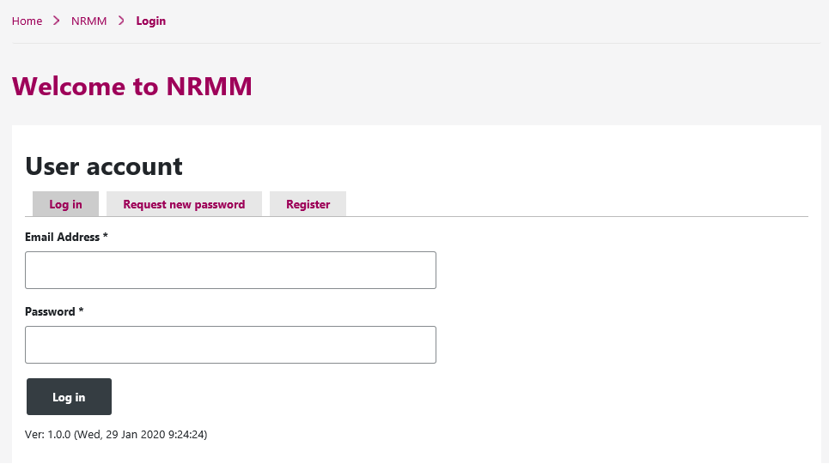
Logging In
The new website now works on a personal login basis as opposed to a general development login
If your email address was used on the old website you may need to request a new password
If not then begin with the register tab
For the purpose of this presentation we will walkthrough as a New User
Users can include any Construction site members involved in the checking and uploading of site/machinery information such as:
Site Managers
Environmental Advisors
Construction worker
Site Administrators

Slide 4
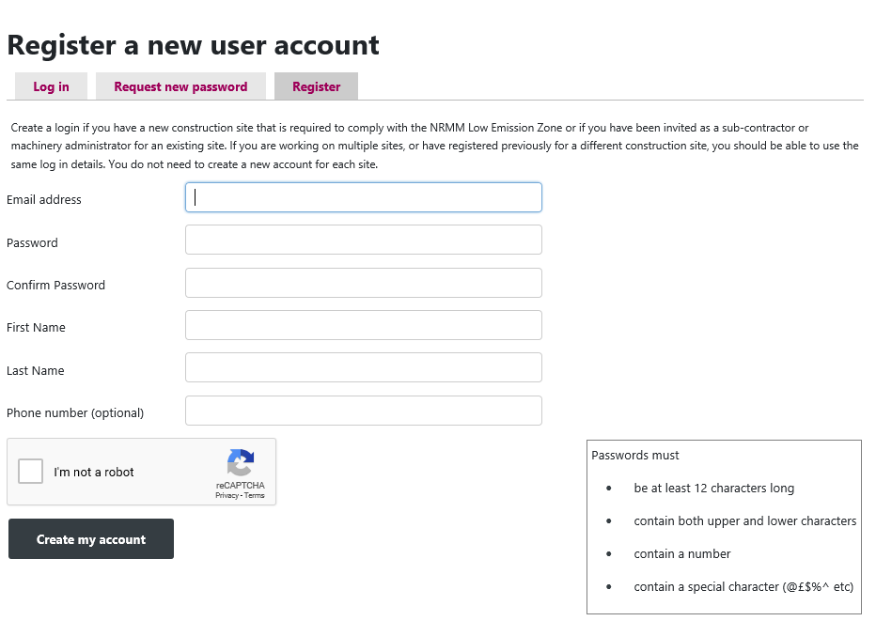
Registering
When registering, all the standard details are required
One important thing to note is the detail required in the password
Once the account is created an email will be sent with a link to activate the account
This may take some time on WiFi

Slide 5
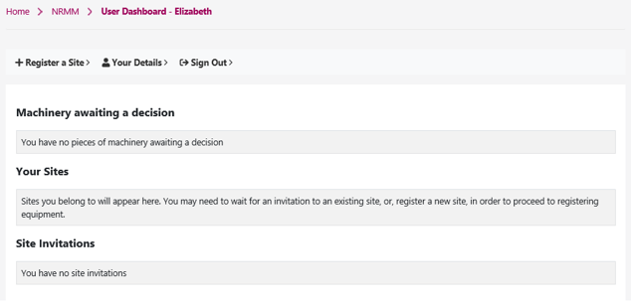
User Dashboard
After logging in you will be met with this home page. You can return back here at any point by clicking the ‘NRMM’ link
Here you can
Update your personal details such as contact number and change your password
Register a development as Principal Contractor

Slide 6
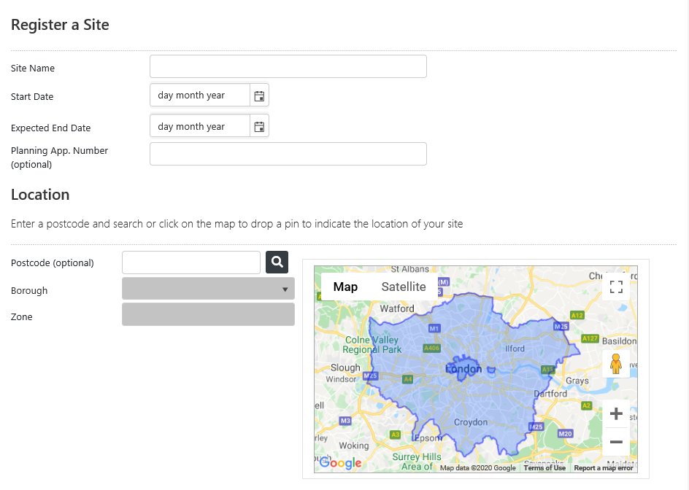
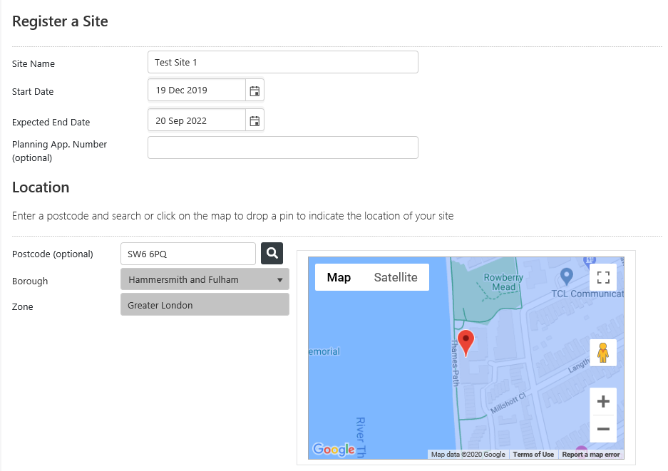
Register a Site
To begin, fill in the required information
After entering the postcode a pin will drop on the map indicating site location and will automatically fill the Borough and Zone
If the pin drop location is not accurate or if you do not know the postcode you can manually pin your site using the map

Slide 7
Once all necessary details are filled simply slide the confirmation to indicate ‘Yes’ and click the Register Site Button
After filling in the site postcode you will then move on to the following (all of which are optional)…
You can enter contact details and send an invitation to an individual to be a Sub-Contractor. Allowing them to add and edit only machines they have personally uploaded on that specific Construction Site
You can enter contact details and send an invitation to an individual to be a Machinery Admin. Allowing them to add and edit all Machinery present on the Construction Site but NOT edit site details
Direct site contact will be used as the first point of contact to arrange an NRMM audit. This will automatically be assigned to the person who registered the construction site. However if this is not you, please enter the details of the most relevant person here

Slide 8
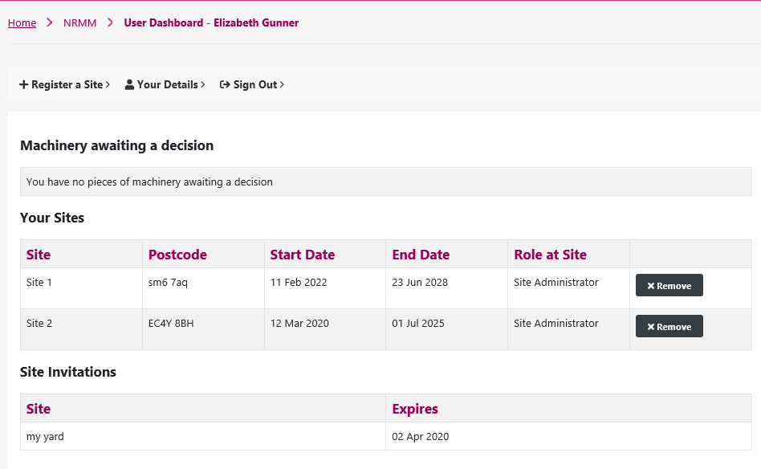
Recorded Sites and Invitations
Once a site is registered you will see it on your User Dashboard
All registered sites will appear here
Site invitations are a great way to manage uploading machinery information particularly
For site managers who are point of contact but not directly managing machinery
For larger sites with multiple sub-contractors who control the arrival and removal of their own fleet
All invitations will appear here where you simply click to accept it

Slide 9
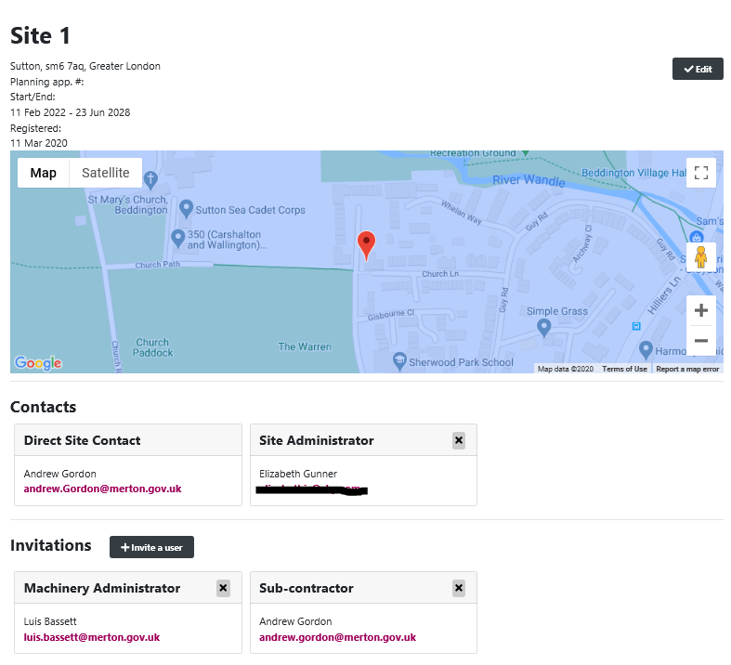
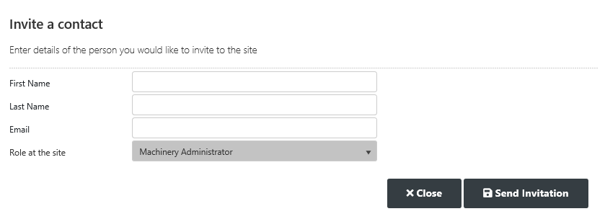
Site invitations
When you click on a site you will be able to see its location along with all the contacts and invited parties
 | Edit Site Details and Send Site Invitations | Upload NRMM and edit all Machinery on Site Record | Upload NRMM and edit personally entered machines
Site Admin |  |  | 
Machine Admin |  |  | 
Sub-Contractor |  |  | 
You can also remove Sub-Contractors and Machine Admins who are no longer on site by clicking the X
All that’s needed to invite someone to a site is Name and Email address and for the appropriate role to be chosen from the drop down list and for the invitation to be sent
You will also be able to invite more individuals to sites here

Slide 10
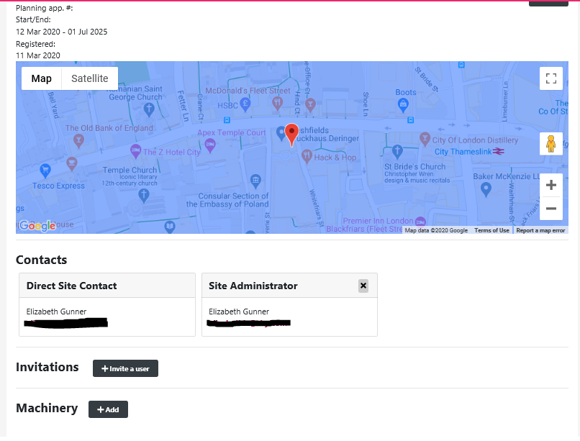
Adding Machinery
To add machinery click the +Add button next to Machinery
7

Slide 11
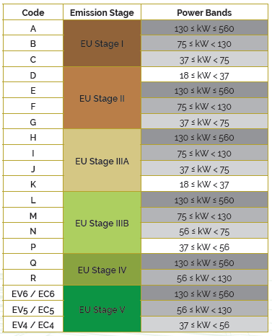
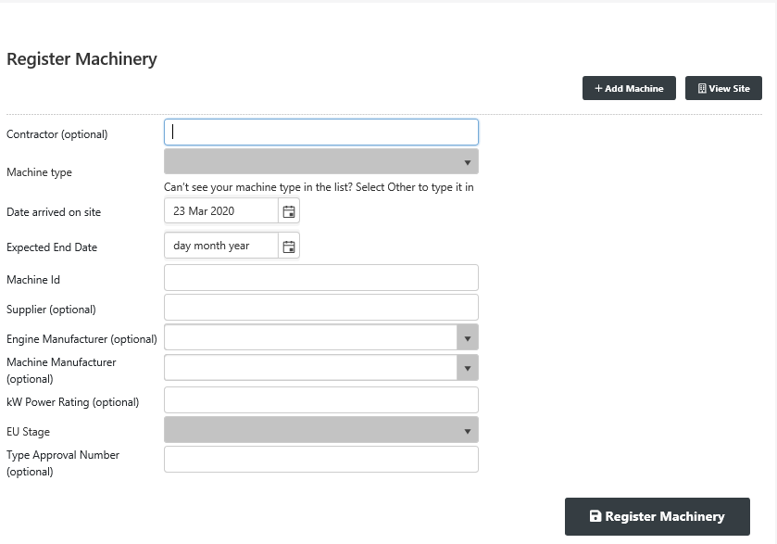
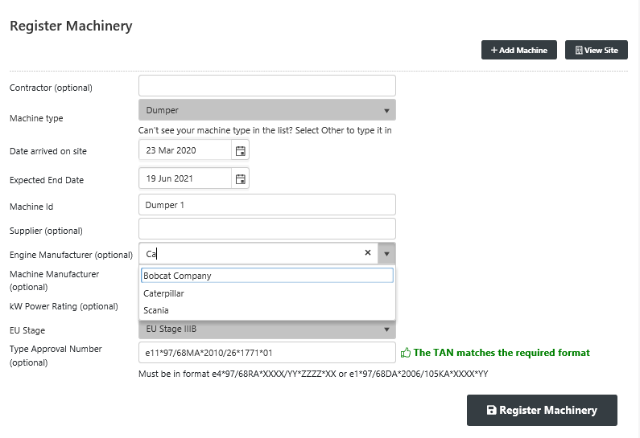
Once information is filled in, you can click the ‘Register Machinery’ button
You can select names through the drop down list or type to start the quick find
Enter as many machine details as possible, the mandatory options are highlighted
The EU Stage for 97/68 TANs can be identified through the letter code
The Type Approval Number (TAN) needs to match one of the formats found in Section 5.2 of the Practical Guide
*Although Type Approval says optional it’s actually needed in order for the website to register the machine

Slide 12
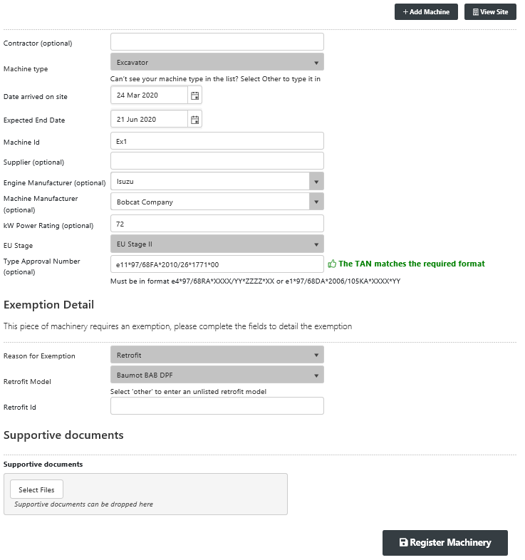
Exemptions and Retrofits
To add a piece of machinery that requires an exemption or has retrofitted emission reduction technology, firstly enter all previously mentioned machine details
For a retrofit
Select ‘Retrofit’ as ‘Reason for Exemption’
Select the Retrofit model fitted to the machine
Insert the ID and upload the Certificate
Click ‘Register Machinery’
For an exemption
Select either ‘Emergency’, ‘Existing exemption’ or ‘Other’ as the reason
Fill in the necessary fields
Click ‘Register Machinery’
When the EU Stage is below the required standard an Exemption section will appear
More information on exemptions can be found in Section 4.5 of the Practical Guide

Slide 13
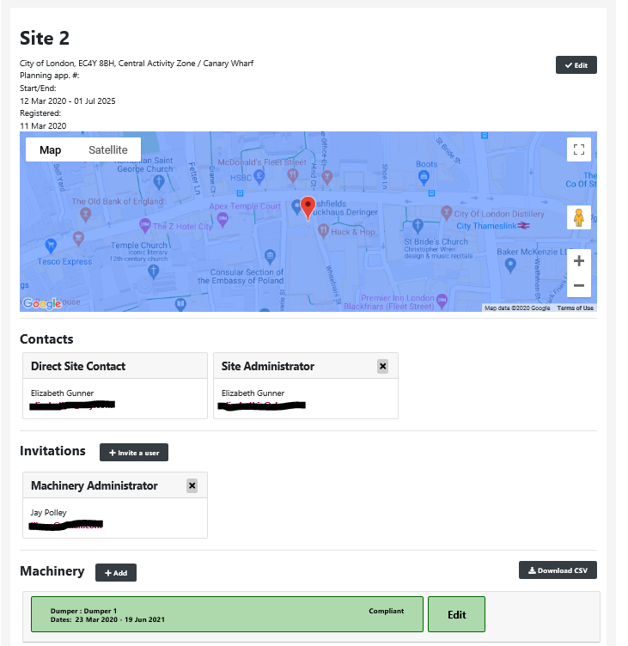
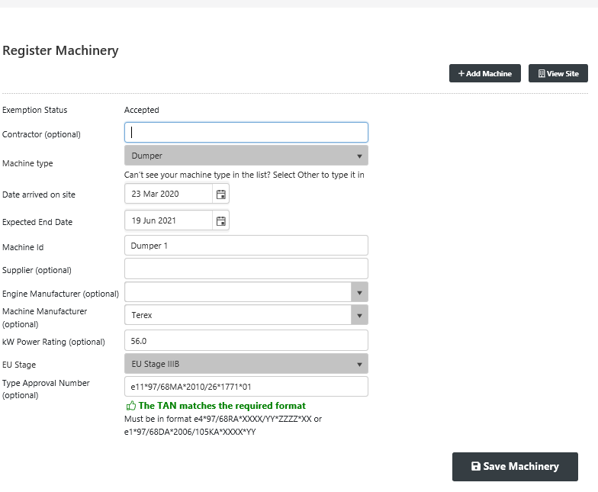
Here you can edit details of the machine and see their status of being ‘Compliant’, ‘Inactive’ or ‘Pending’
Your machine will now be registered and after clicking the ‘view site’ button you will be taken back to the site page and see all registered machinery
Inactive is for machines that have now reached their deployment end date. This can be edited if the machine leaves earlier or stays longer
Pending is for exemptions applied for, which can also be seen on the User Dashboard

Slide 14
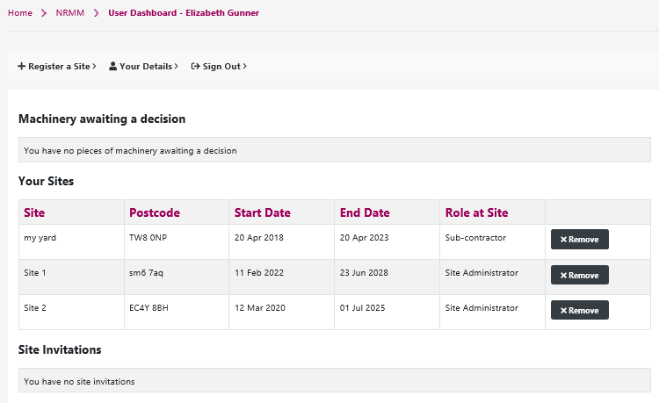
Handing over a site
If you’re the only Site Admin you will not be able to remove yourself from the site
If the person responsible for the construction site changes you can hand over sole responsibility of a site
Registered sites must always have at least 1 site administrator so you must invite someone to be a Site Admin and have them accept before being able to remove a site from your personal account
Once they have accepted the invitation, you can remove yourself from that development

Slide 15
Identifying What is ‘In-scope’ NRMM

Slide 16
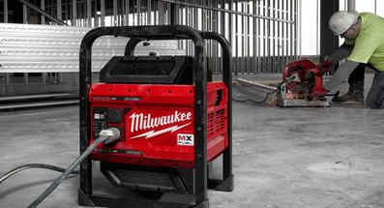
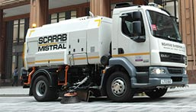
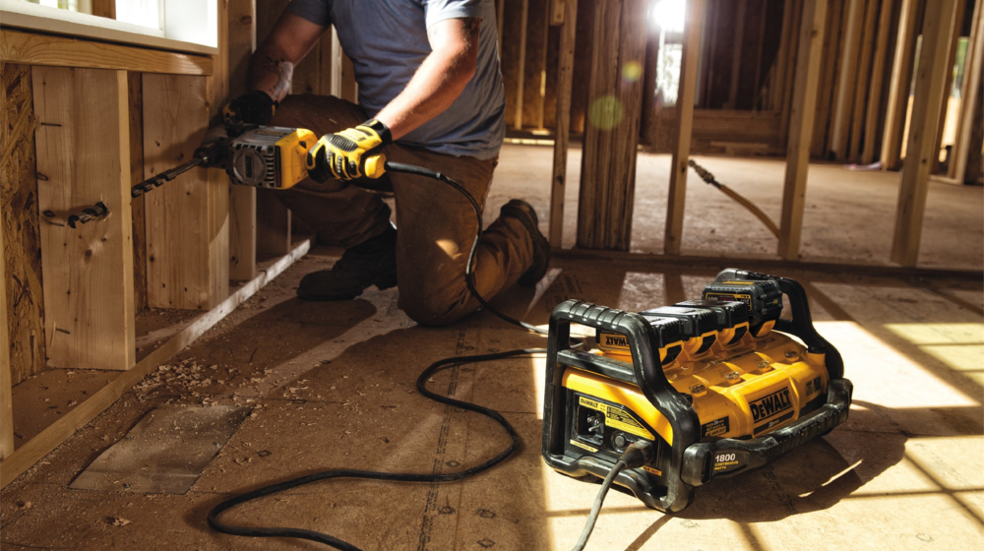
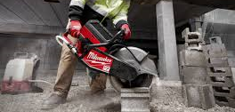
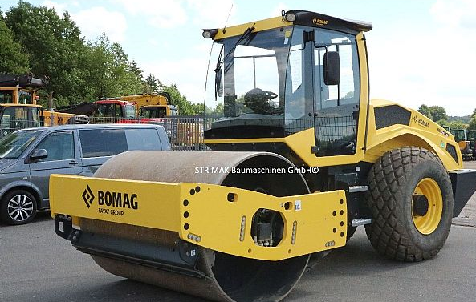
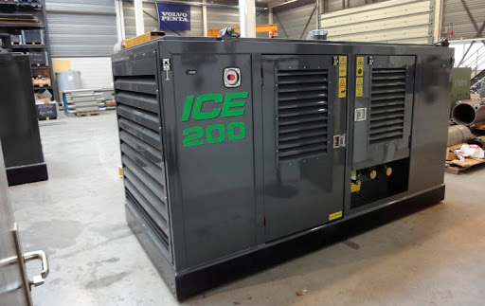
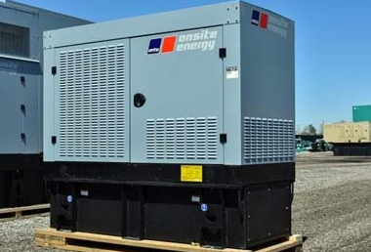
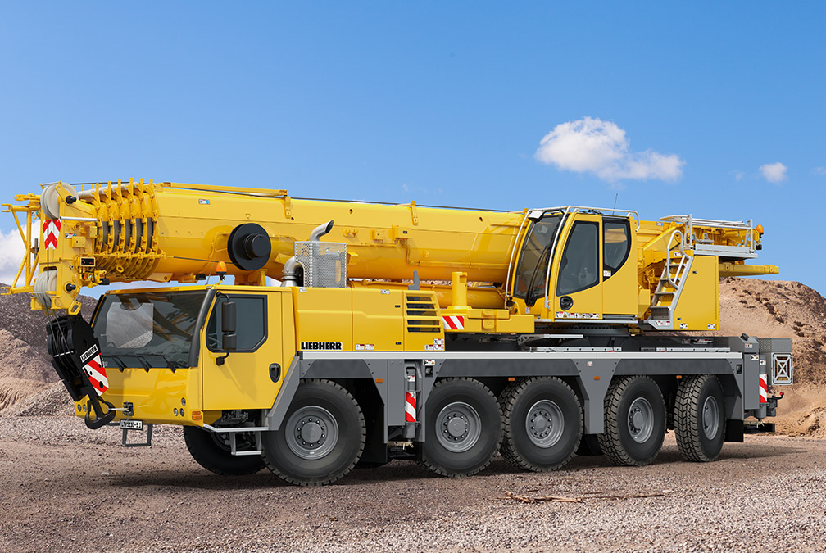
What machines are classed as NRMM?

Some of the most common items we audit are covered in Section 2 of the Practical Guide.
The key factor is it must be powered by a diesel engine and be above 37kW


Slide 17
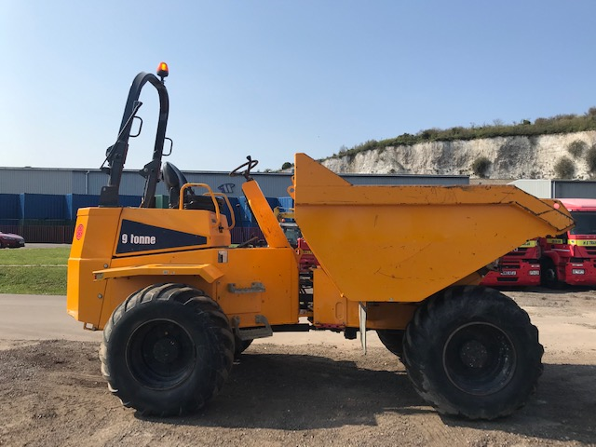
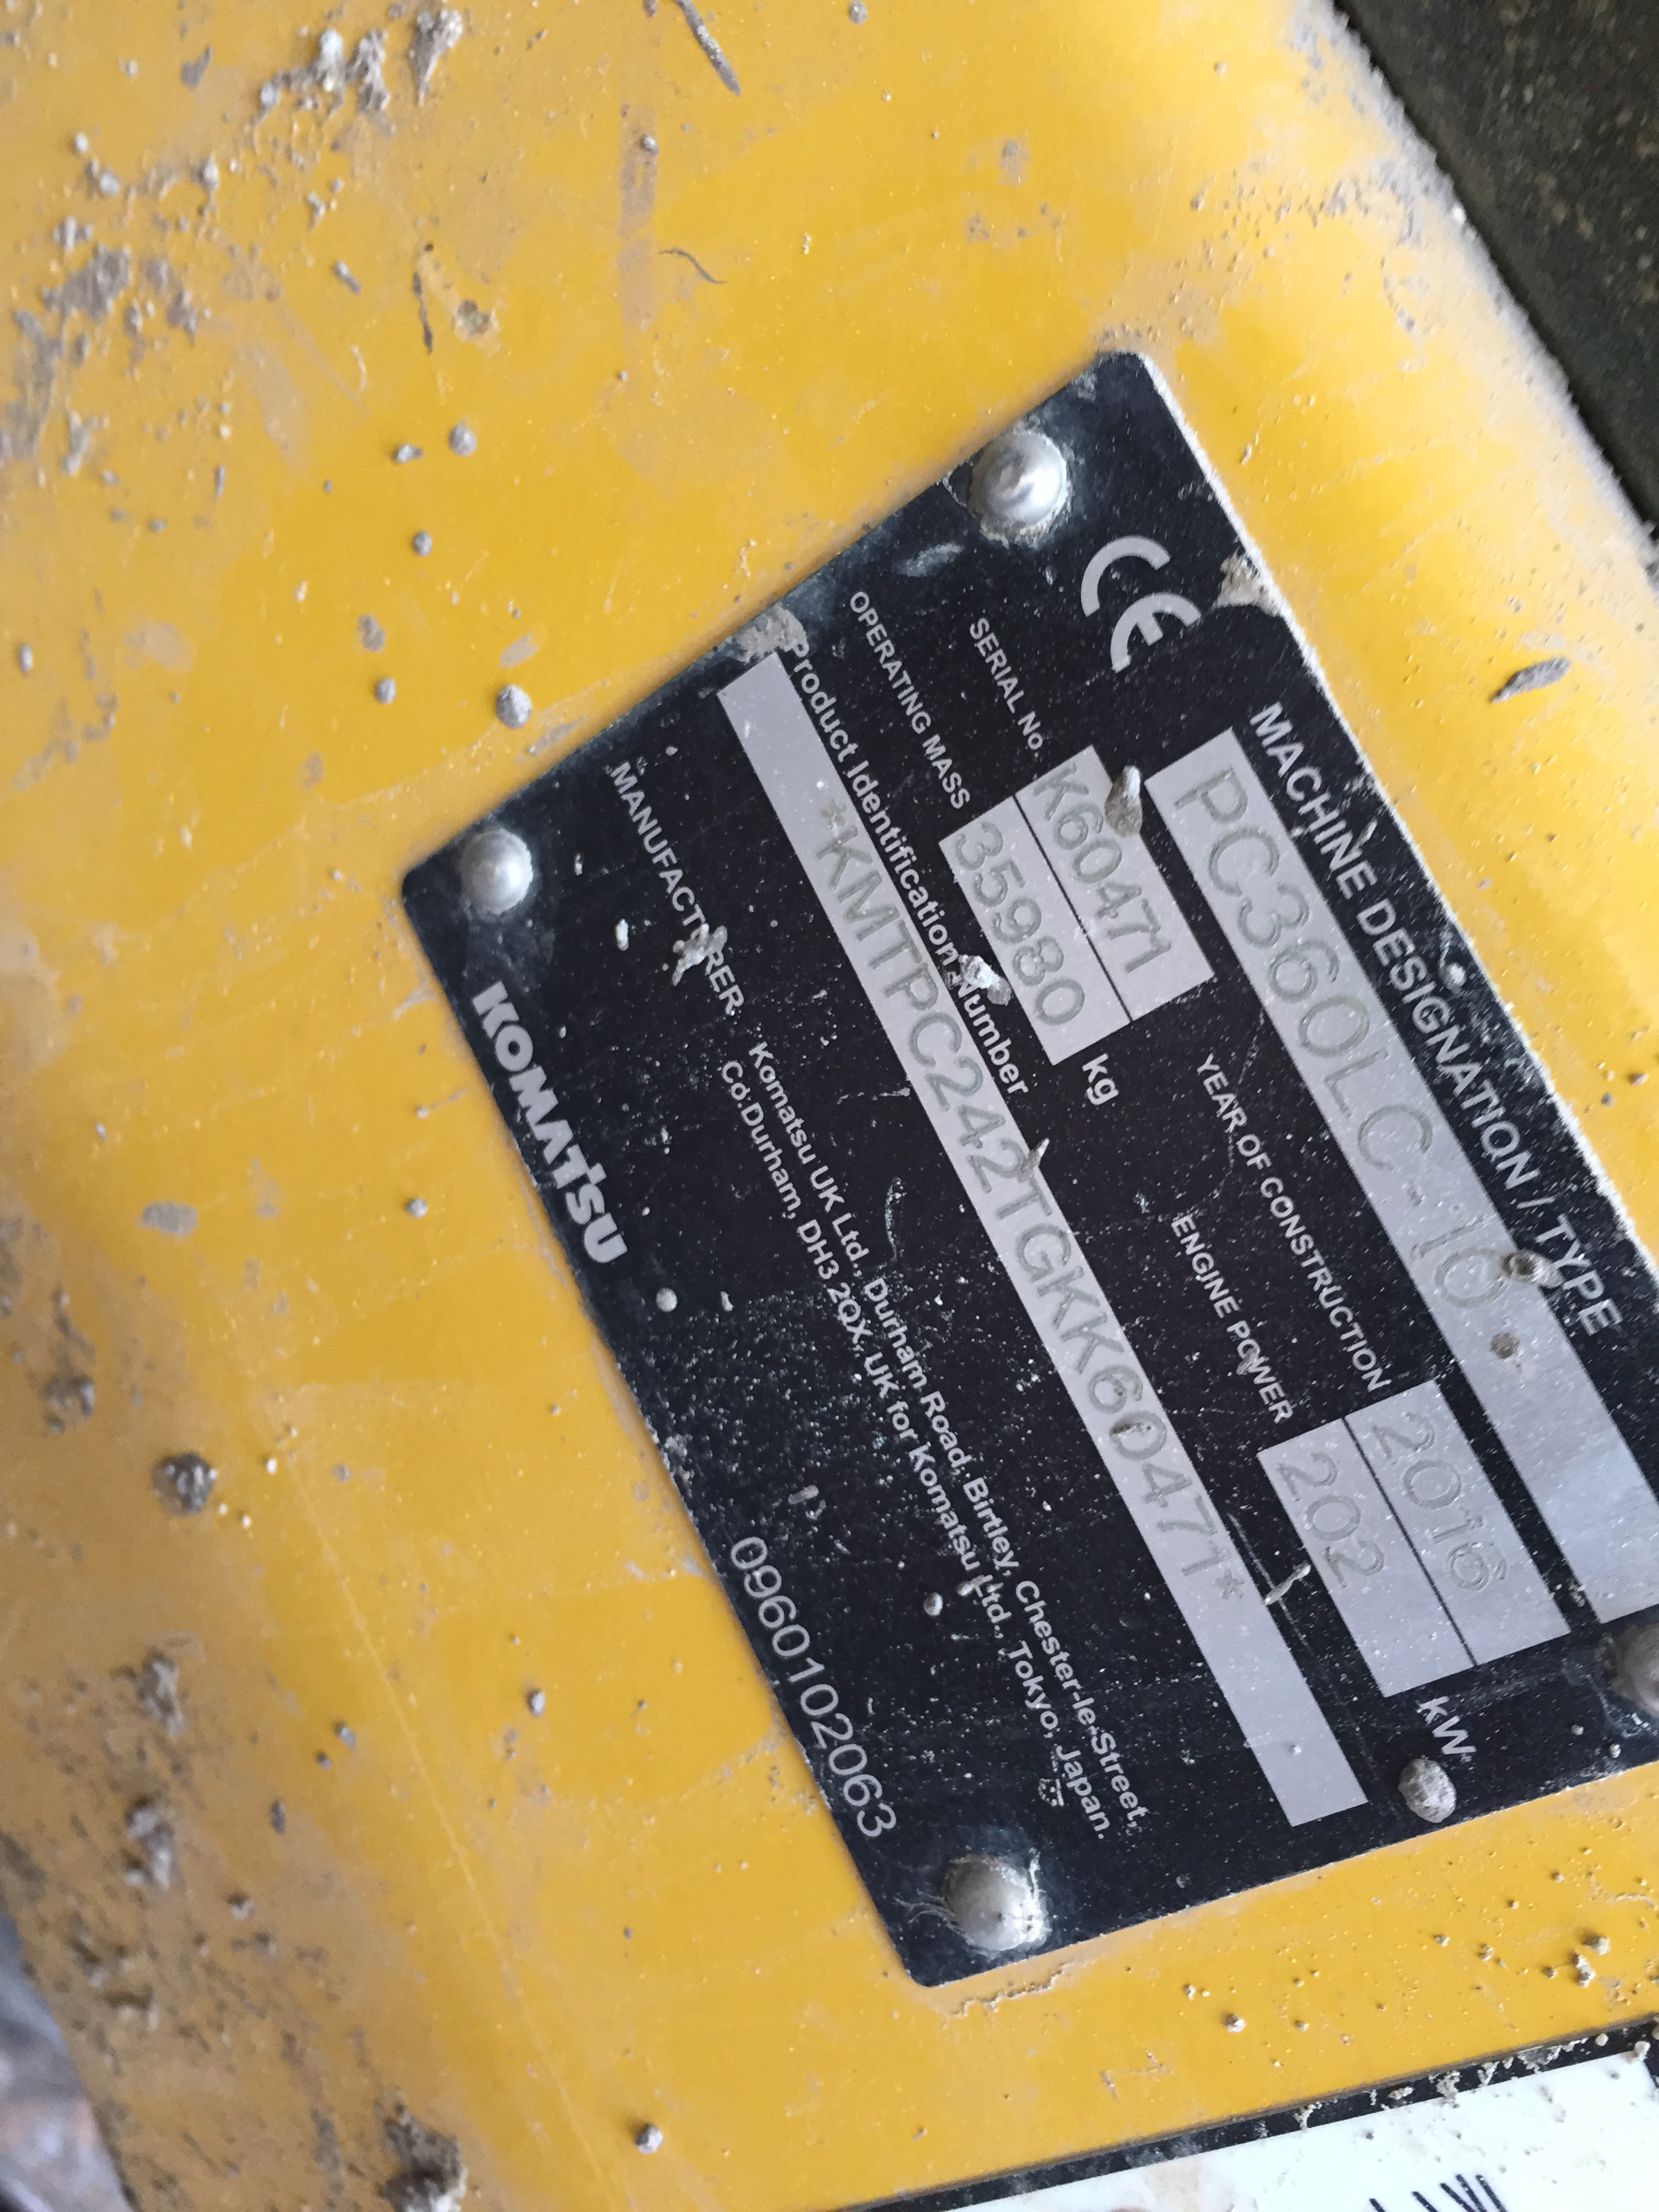
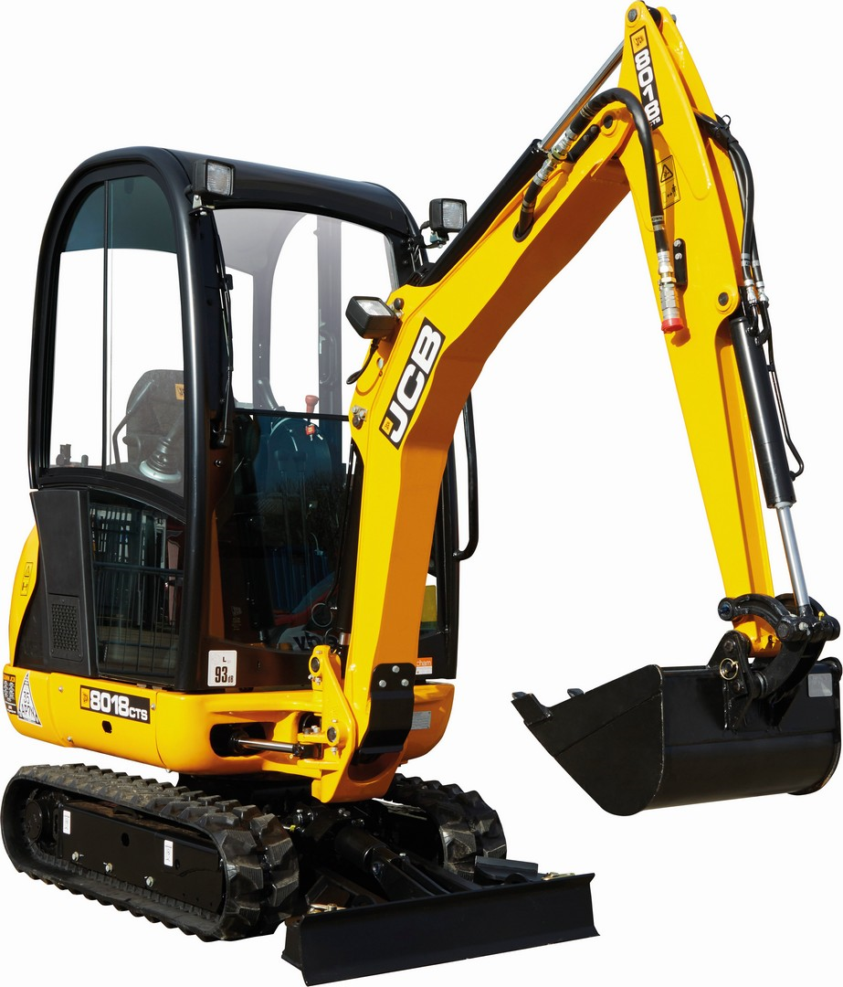
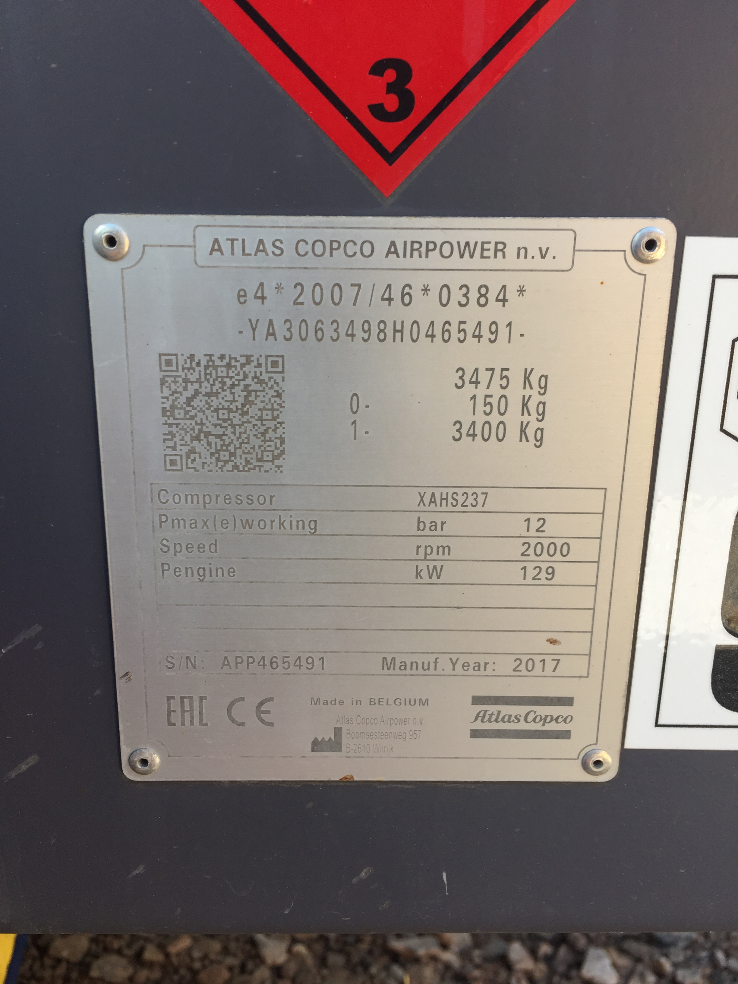
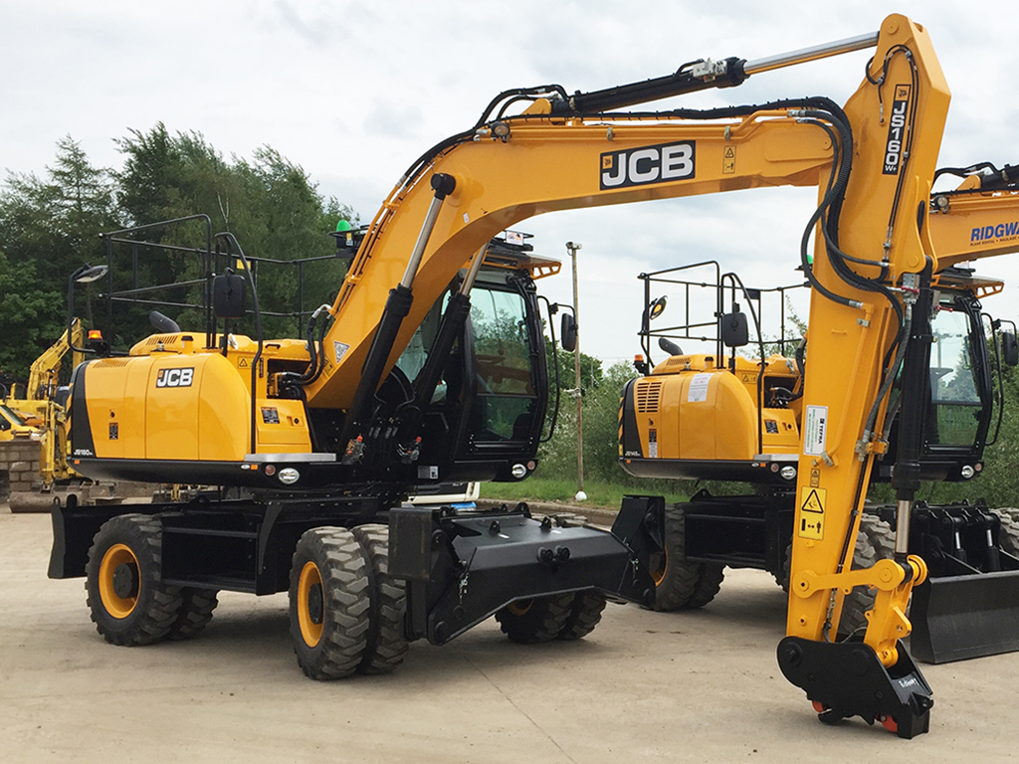
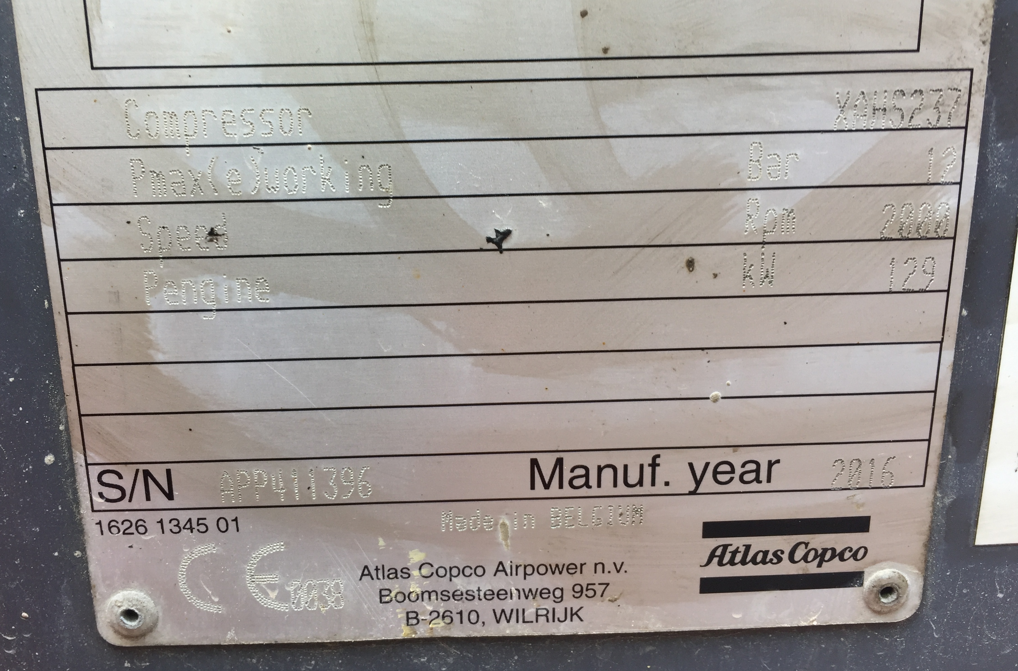
In-scope?
It’s important to note VIN plates do not usually have the TAN present. This will be found on an engine plate, for more information and examples check out the Practical Guide.
Easiest way is to check the VIN plate
Most VIN plates are pretty straightforward to read kW power from
These are usually located on the front of the machine somewhere close to the cabin/driver seat or in the case of skid steer inside of the cabin1
It is likely that anything smaller than a 6 tonne excavator will be under 37kW with a few exceptions such as compressors but it’s good practice to check!

Slide 18
If you have any questions please feel free to contact our officers or email NRMM.LONDON@merton.gov.uk

