Slide 1
Abbey Road Houses
May 2023
Presentation for existing residents of Abbey Road

Slide 2
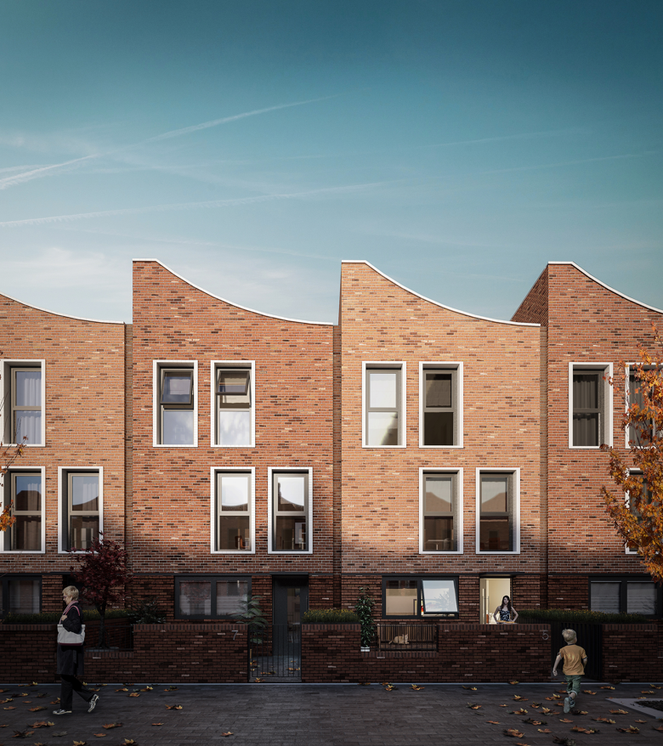
Details of the new Abbey Road Houses

Slide 3
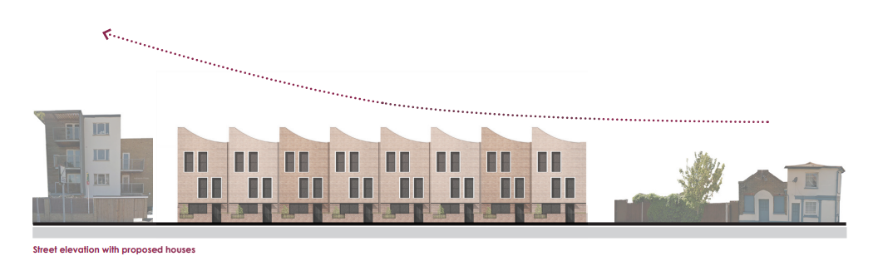
Street elevation

Slide 4
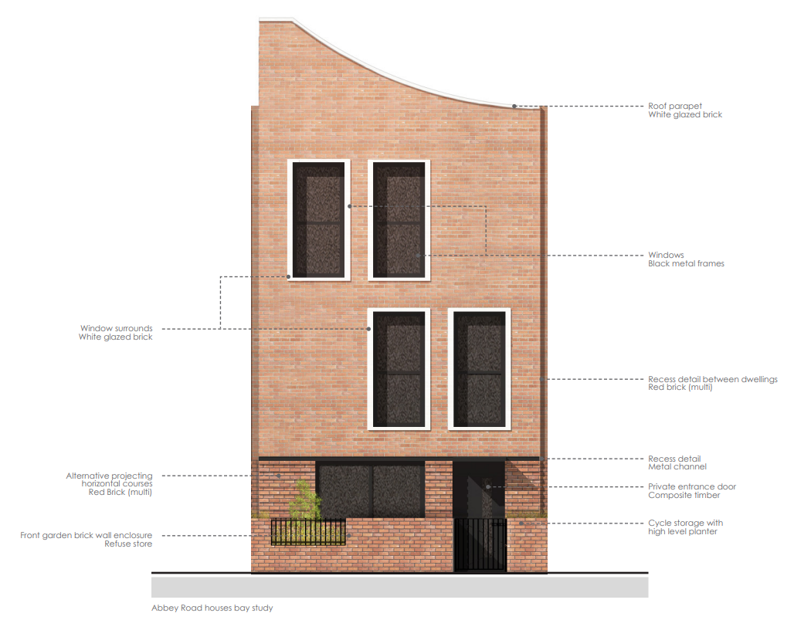
House in detail

Slide 5
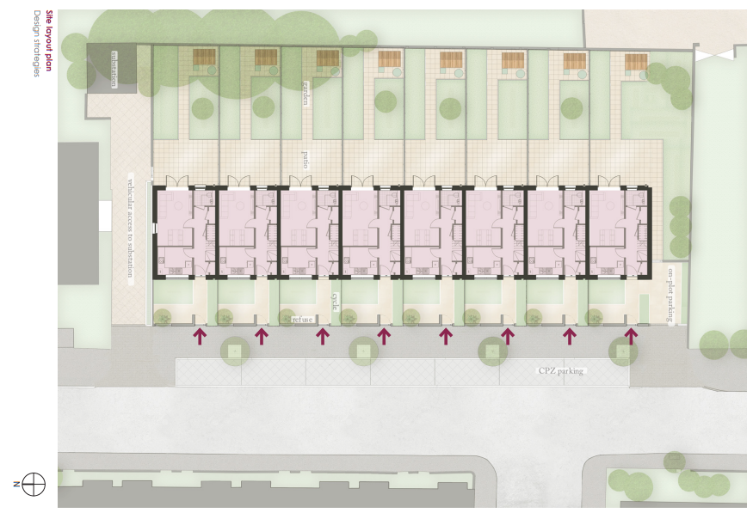
Site layout plan

Slide 6
Set back from Abbey Road

Slide 7
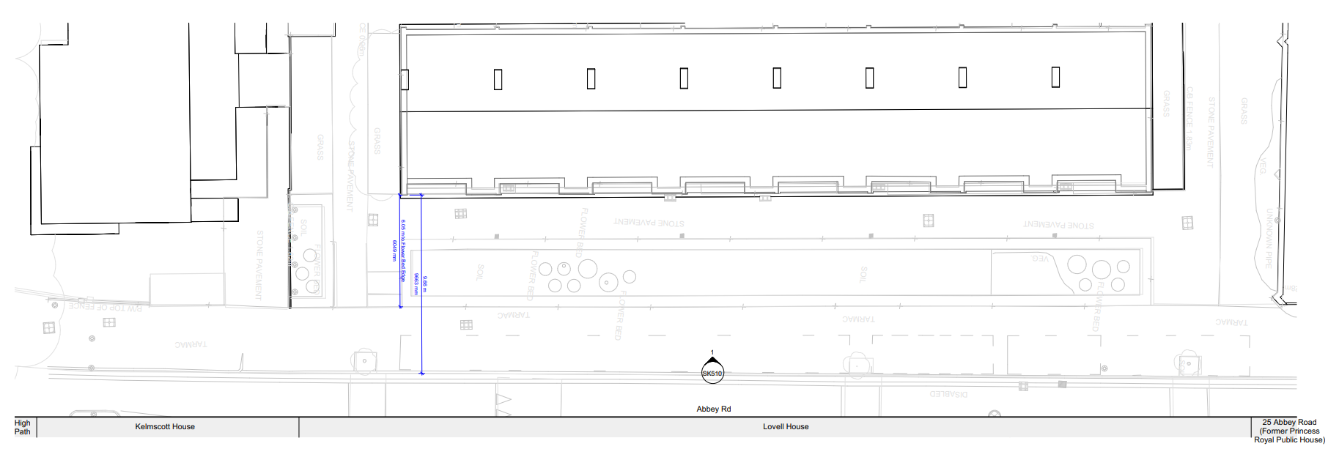
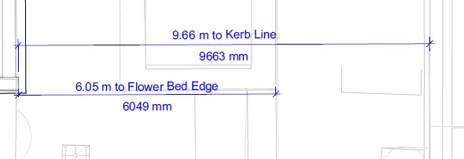
Existing building – set back from road – 9.66m

Slide 8
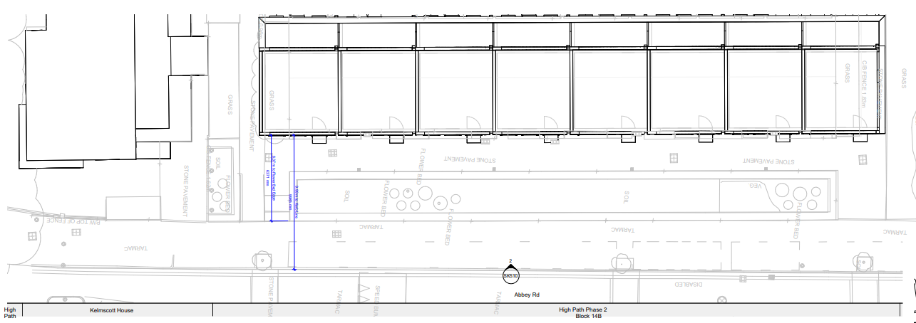
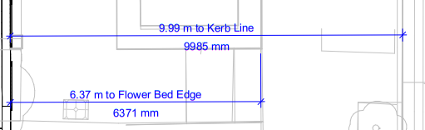
New building – set back from road – 9.99m

Slide 9
Building Heights

Slide 10
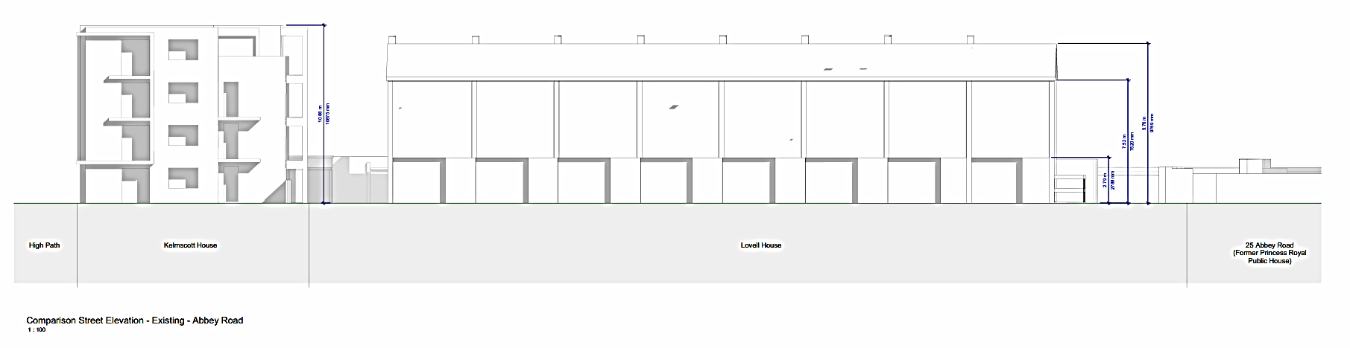
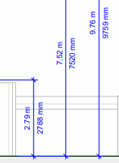

Existing building – 9.76m at roof line

Slide 11
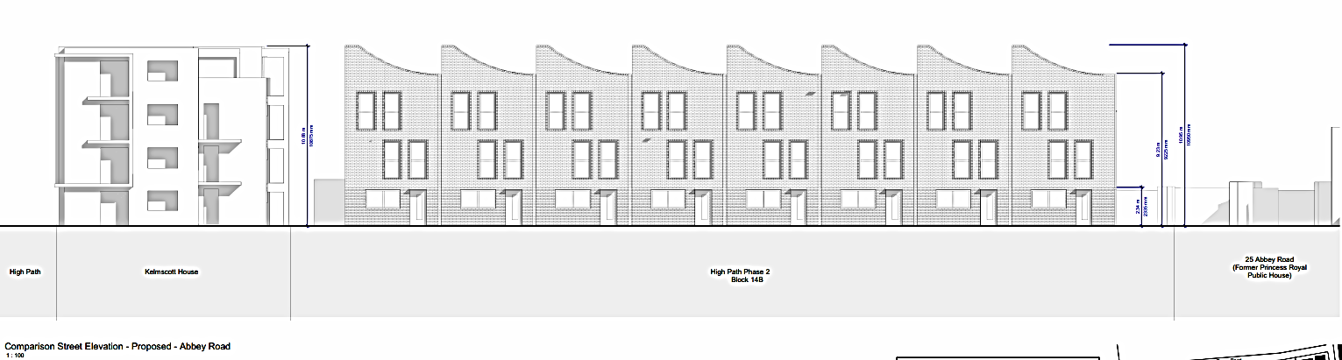

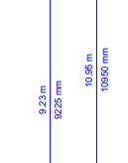
New building – parapet 9.23m at lowest point and 10.95m at highest point

