Slide 1
Accident/Incident Reporting and Potentially Violent Persons (PVP) System
Reporting an accident or incident as a Merton employee (using your Employee number)

Slide 2
.
CORPORATE GUIDANCE FOR STAFF AND MANAGERS ON REPORTING ACCIDENTS, INCIDENTS, VIOLENCE AND AGGRESSION.
Introduction
As an employer the Council has responsibilities to record all workplace accidents/incidents and to report specific accidents/incidents to the enforcing authority (HSE). There is also a requirement to carry out accident/incident investigations and to put in place remedial measures to prevent recurrence.
Note: Council staff with access to the council’s intranet home page may also access the new system via the intranet the home page “ more popular pages” drop down menu on the left hand side labelled accident incident and aggression reporting. This will take you directly to the new form.
The online report form has been designed to be as user friendly as possible and there is help throughout. It requires the completion of a number of questions that fall into two main parts: (i) general information about the injured person and the nature of accident AND (ii) the accident investigation. Once a form has been entered onto the system the relevant line manager will be informed via automated email and invited to complete the investigation part of the form.
Accident /Incident reporting to the Enforcing Authority (HSE)
Certain types of accident and incident must be notified to the enforcing authority within prescribed timescales. The Line Manager of the injured person is responsible for reporting accidents/incidents under RIDDOR to the HSE from the information provided by the injured person and in accordance with the flow charts at the back of this document. Where relevant criteria are met during completion of the form the manager will be provided with a link to report the details to the HSE.
Accident/Incident Investigation
All managers are responsible for accident/incident investigation. The main aim of the investigation is to pinpoint the causes of accidents/incidents and take prompt and effective action to prevent recurrence. The system guides those undertaking the investigation through the process ensuring they:
Focus on establishing the facts e.g. what happened, to whom, where and the outcome
Focus on how and why, giving the immediate cause or loss, and then the secondary or contributory causes
Focus on any preventative measures needed to prevent recurrence
More detailed guidance on the investigation process can be obtained from the Corporate Guidance on Accident/Incident Reporting for Employees and Managers available from https://www.merton.gov.uk/business-and-consumers/health-and-safety/health-and-safety-for-merton-staff-and-contractors or by contacting the Safety Services Section by emailing us at health.andsafety@merton.gov.uk or by phoning 0208 545 3388

Slide 3
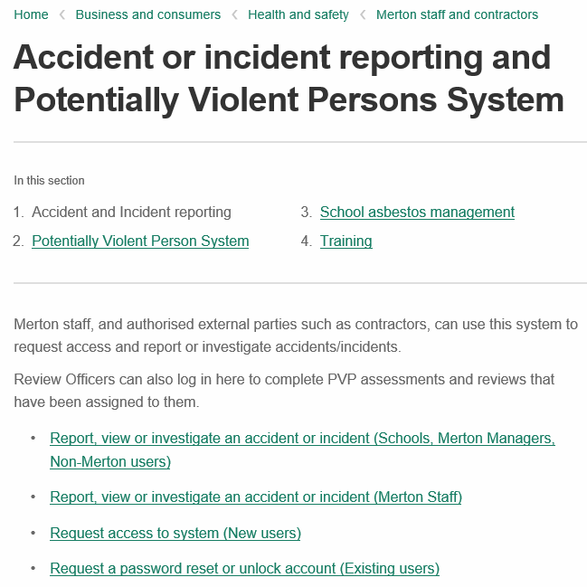
Accident/Incident Reporting & PVP system – Employee Reporting
If you are a Merton employee, with a Merton payroll number, you are able to report your own accident by selecting the link highlighted below.
You will need your employee (payroll) number from iTrent.

Slide 4
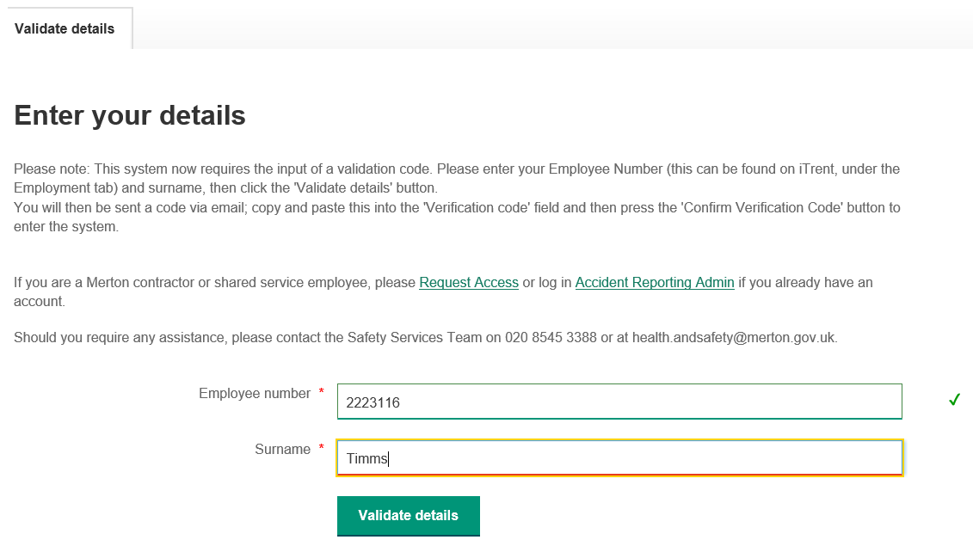
Accessing the system – Login details
Enter your employee number and surname, then press Validate details. This will send you an automatic email with a validation code to enter.

Slide 5
Accessing the system 2 - Verification
Enter the verification code from the email and press Confirm Verification Code to continue.
NOTE: You only have 5 attempts to enter the correct details on this page or you will be locked out. If this happens, please contact the Safety Services team at health.andsafety@merton.gov.uk or call 020 8545 3388.

Slide 6
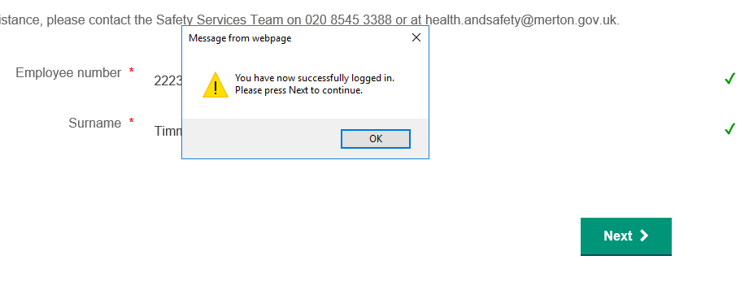
Accessing the system – Logging in
1
2
Once the code has been entered, press OK and then press Next, as shown.

Slide 7
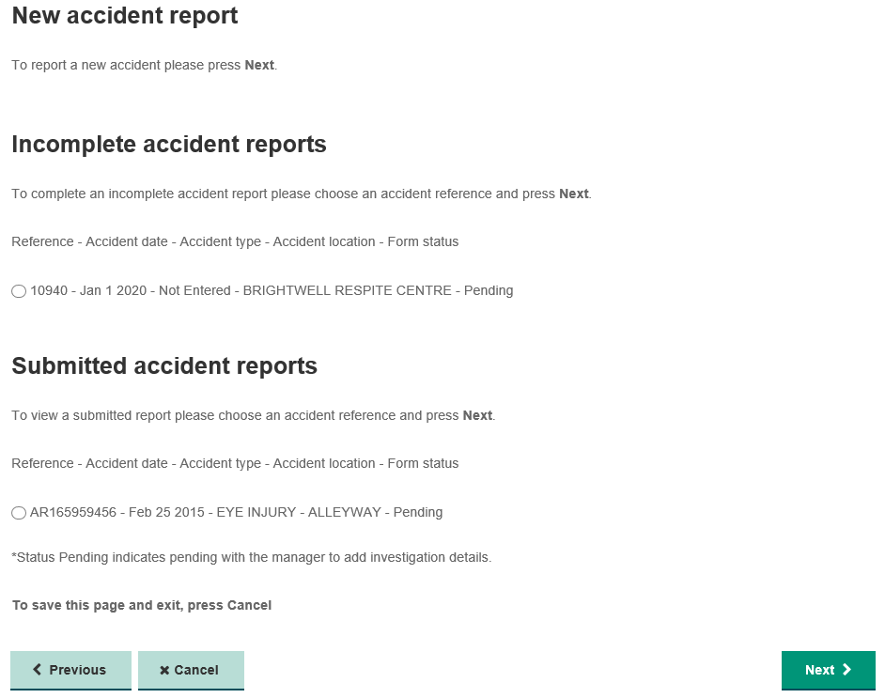
System Homepage
To report a new accident or incident, scroll right to the bottom of the page and press Next.
Any reports which have been started but not finished will appear here. They can be completed by clicking on the accident and pressing Next.
Submitted accidents can be viewed by selecting them and pressing Next.

Slide 8
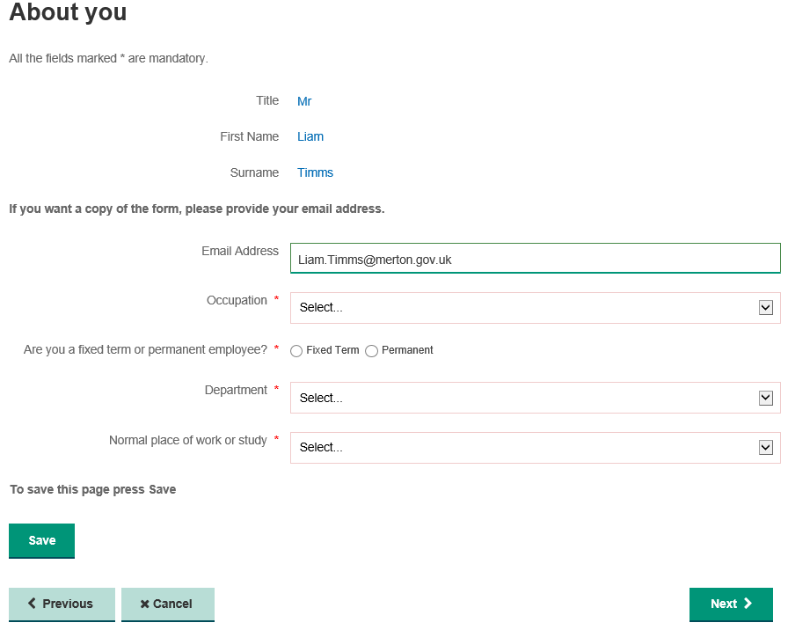
Reporting an Accident – About you
Fill out the form with your details and press Next.
NOTE: Your email address is automatically populated, however you can change it if it is not correct.
NOTE: You must ensure that you select your Department correctly, otherwise you will not be able to forward the report to the correct manager!
NOTE: You can use this button to save your progress at any point in the form; then press ‘Cancel’ to leave the form.

Slide 9
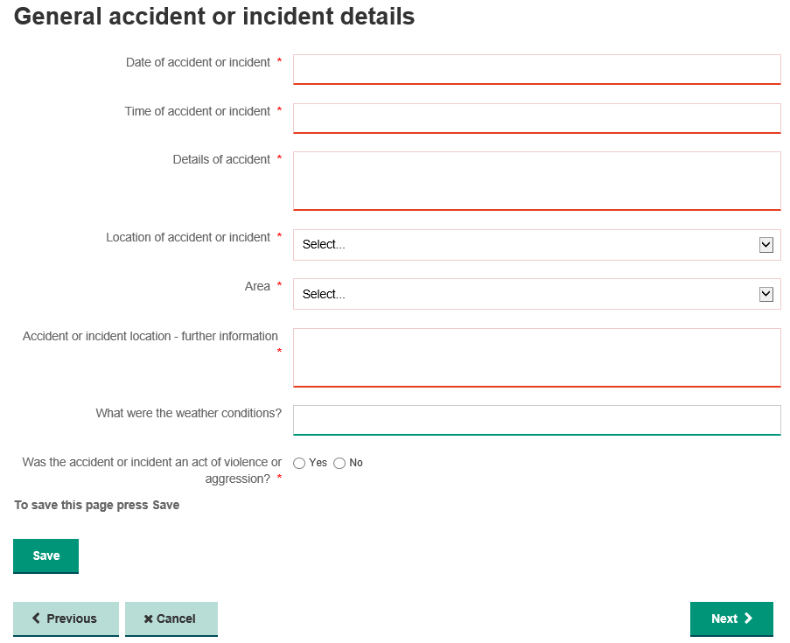
Reporting – General accident details
It is important that you select ‘Yes’ if you believe the incident to be an act of violence or aggression (see Corporate Policy on Violence at Work).

Slide 10
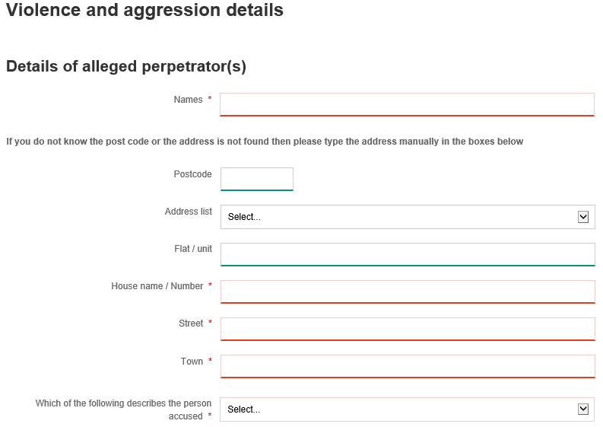
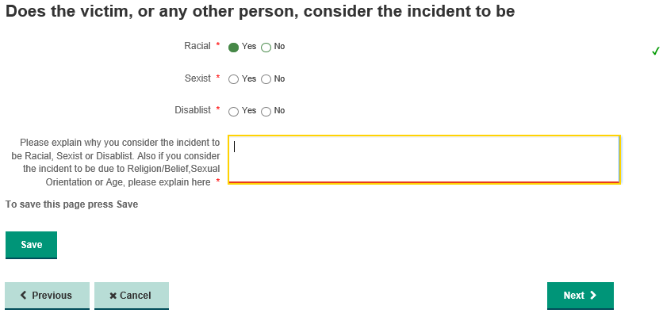
Potentially Violent Person Details
NOTE: If you did not mark the incident as violent or aggressive then move onto the next slide. Otherwise fill in the details and press ‘Next’.

Slide 11
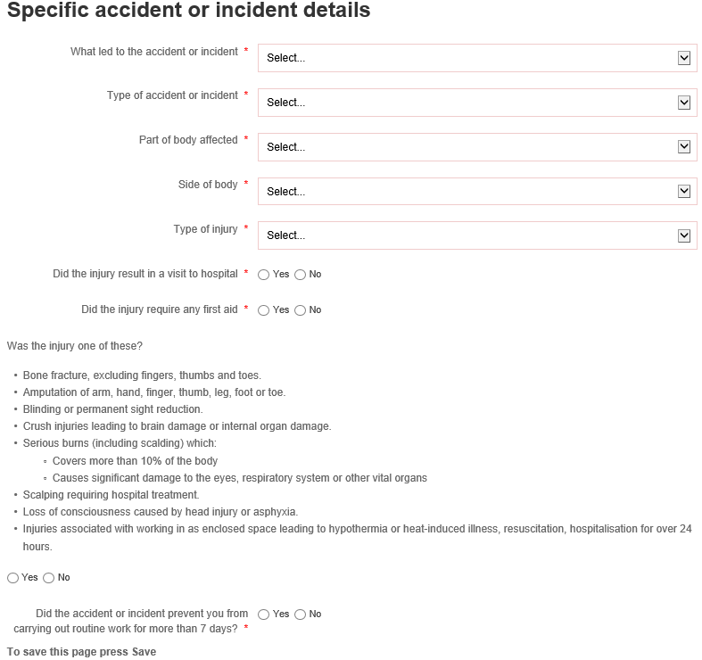
Reporting – Specific accident details
Please ensure these questions are answered correctly as they will determine whether this must also be reported to the Health and Safety Executive under the Reporting of Injuries and Diseases and Dangerous Occurrences Regulations (RIDDOR)

Slide 12
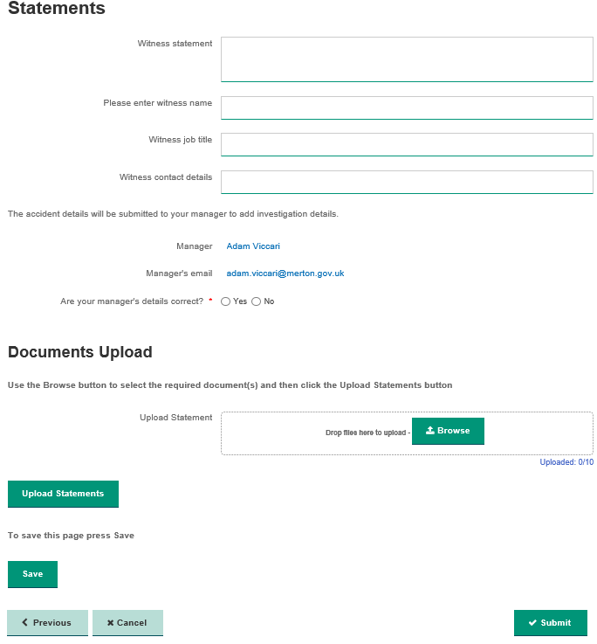
Reporting - Statements
If your manager’s details are correct press Yes and on submission it will assigned to your manager
If your manager’s details are not correct press No and type your manager’s full name and email address
You can now upload Witness Statements to the form. To do this, click Browse and find the document you wish to attach. Once it has appeared in the box, press the Upload Statements button.
Once you are satisfied with the report, press Submit to send it to your line manager.

Slide 13
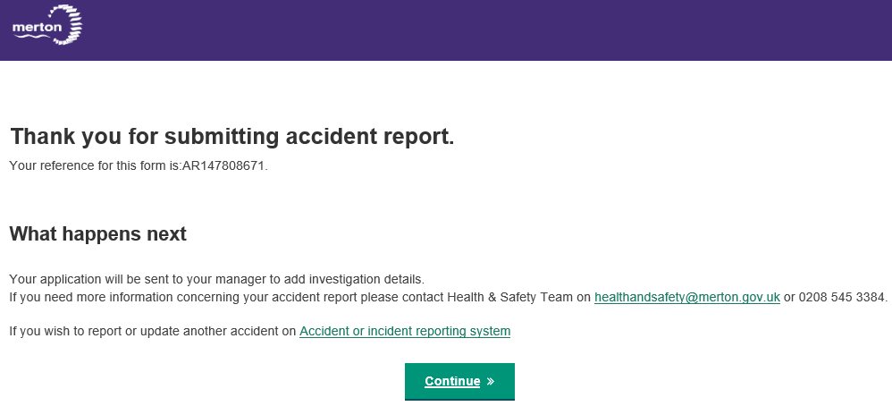
Reporting – Form submission
You have now submitted your accident/incident report and it has been submitted to your chosen manager. They will need to request access to the system, if they have not already, and log in to complete the investigation findings.

