Slide 1
Accident/Incident Reporting & Potentially Violent Persons (PVP) System
Using the accident/incident & PVP system if you are a Head teacher, School Business Manager/administrator or Manager in Merton.

Slide 2
How to use this guide
This guide is designed to walk you through the entire process of logging in, reporting, investigating and submitting accidents/incidents.
If you need information on how to perform a specific task on the system, you can jump right to the relevant section from the Contents page on Slide 3.

Slide 3
Contents of this Guide
Introduction & how to log in – Slides 4 - 6
Changing your password – Slide 7
Viewing Pending and Completed Forms – Slide 8
Start a report for a Merton employee (with an Employee Number – Slide 9
Start a report for a non-employee (pupil, schools staff etc.) – Slides 10 - 14
Layout of the Report – Slides 15 - 23
Filling in Investigation Findings – Slides 24 - 29

Slide 4
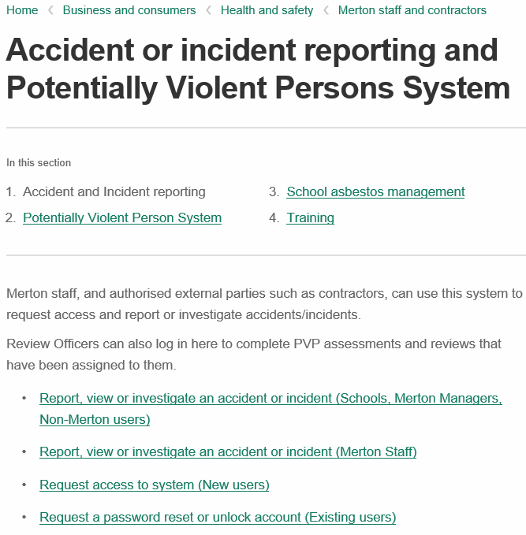
Accident/Incident Reporting & PVP System – Introduction & Login
This guide is only concerned with logging in as a Merton Manager, Head teacher/School Business Manager or Non-Merton employee to report, view or, where an employee/Admin has forwarded you a report, to complete the investigation findings.
If you already have a User ID and Password, click here to log in.
If you don’t have a User ID and password to login, click here to fill in a request.

Slide 5
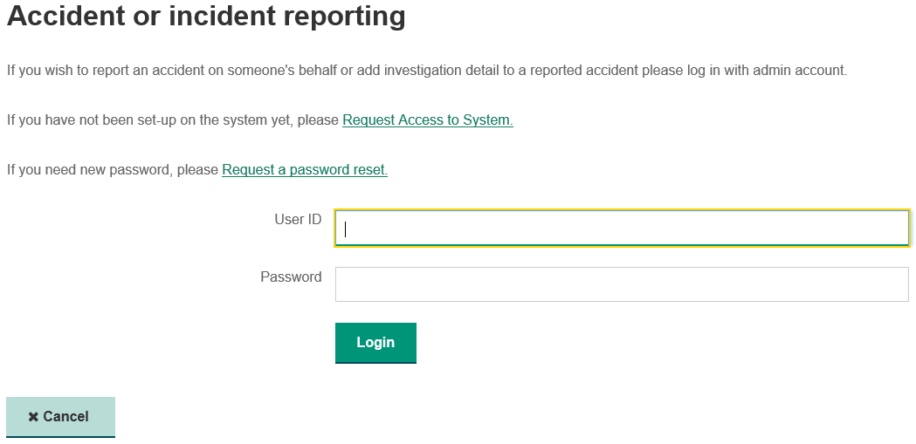
Logging into the system
If you have already been given a User ID and password by the Safety Services team, enter it here and press Login. If not, please see the NOTE in red.
NOTE: If you don’t have a User ID and password to login, click here to fill in a request.
NOTE: You only have 5 attempts to enter the correct User ID and password or your account will be locked. If this happens, please press the Request a password reset link and fill in the form for a reset request.

Slide 6
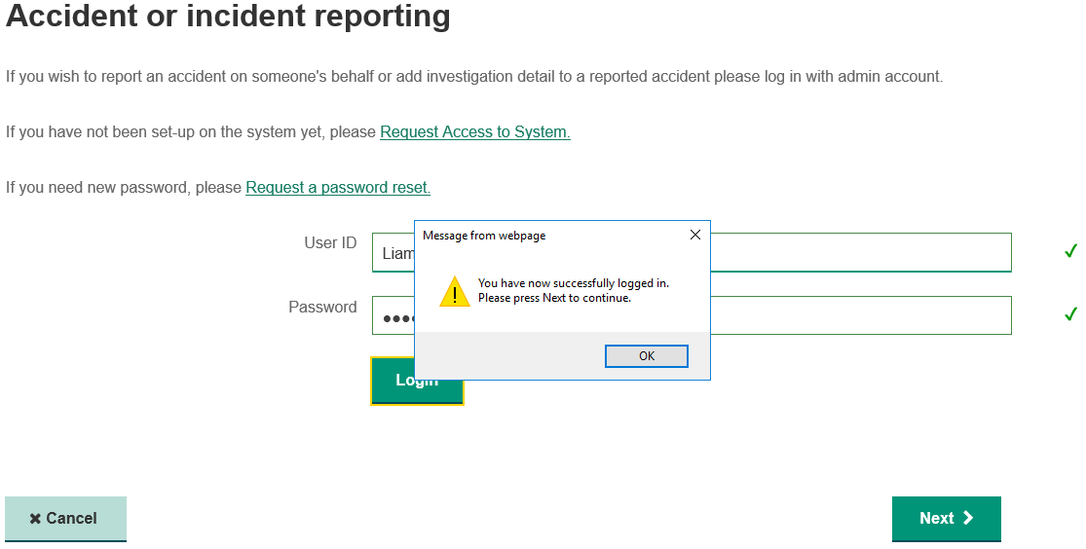
Logging into the system
Once you have entered your User ID and Password and pressed Login, a pop up will appear, press OK and then Next.
1
2

Slide 7
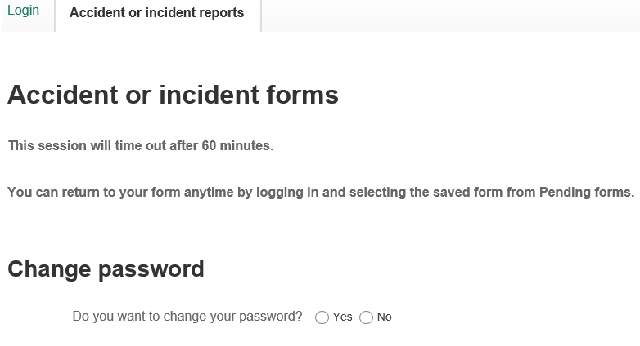
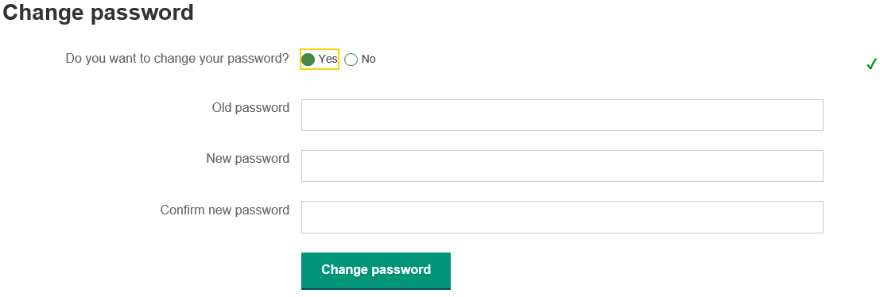
System Homepage – Change Password
You will have multiple options once you have logged in, the first is to change your password. You only need to do this the first time you’ve logged into the system with a generic password sent by automated email.
NOTE: Passwords must be 9 characters long and made up of digits, upper and lower case letters and special characters. Your password will not change if these criteria are not met.

Slide 8
System Homepage – Pending and Completed Forms
You can complete the investigation of an existing accident/incident report from the list displayed under the ‘Pending Forms’ heading. To do this, click the toggle then scroll to the bottom of the page and press ‘Next’.
2
1
OR
If you wish to view a form you have previously completed, scroll to the ‘Completed Forms’ heading and select the toggle for the form you wish to review, then scroll to the bottom of the page and press ‘Next’
2
1

Slide 9
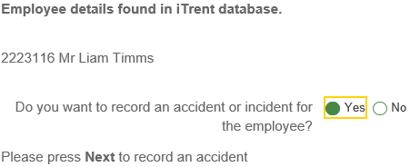
System Homepage – Starting a report for a Merton employee
The easiest way to report an accident/incident on behalf of a Merton employee is searching using their employee (payroll) number. This can be found on iTrent by the employee’s line manager. Type the number into the field and press Search.
If the employee number is correct, the employee will appear as shown. To begin reporting, select Yes, scroll down to the bottom of the page, and press Next.
NOTE: If you cannot find the employee’s payroll number, follow the process on the next slide to add them to the database manually.

Slide 10
System Homepage – Reporting for any person without an Employee number
To report for anyone who is not a Merton employee (i.e. pupils, schools staff, shared service staff etc.), type their surname and date of birth (if known) as shown below, then click Search.
NOTE: It is not compulsory to enter the injured person’s date of birth at this stage; however, if the accident is reportable under the Reporting of Injuries, Diseases and Dangerous Occurrences Regulations (RIDDOR), you will need their date of birth to report it to the Health and Safety Executive
Once you have clicked Search, the following pop up window will appear, showing the details of any persons on the database with the surname entered. If the correct name is present, select the toggle for the correct person and then click Select to continue.
NOTE: If you cannot find the correct person, you will need to add them – see this slide
1
2

Slide 11
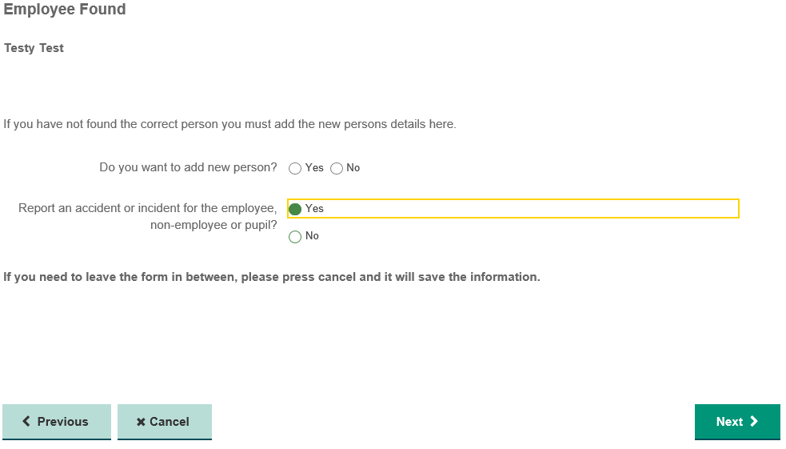
System Homepage – Reporting for any person without an Employee number
Once you have selected the right person from the database, click Yes and then Next to move onto reporting the accident/incident
NOTE: As before, if you cannot find the correct person, you will need to add them manually – see this slide for instruction on how to do this.

Slide 12
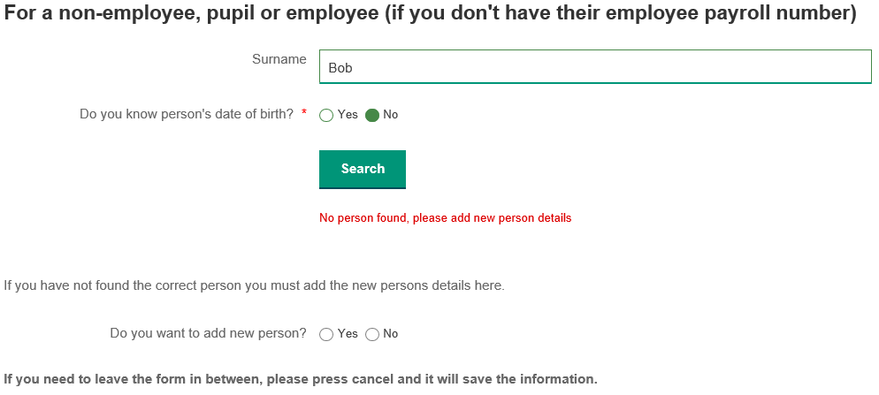
System Homepage – Reporting for any person without an Employee number
If you were unable to find the right person on the database, you can add them manually by selecting ‘Yes’ to ‘Do you want to add a new person?’ As shown below:
NOTE: Selecting Yes will prompt a set of fields to appear asking for the person’s details; this is shown in the next slide.

Slide 13
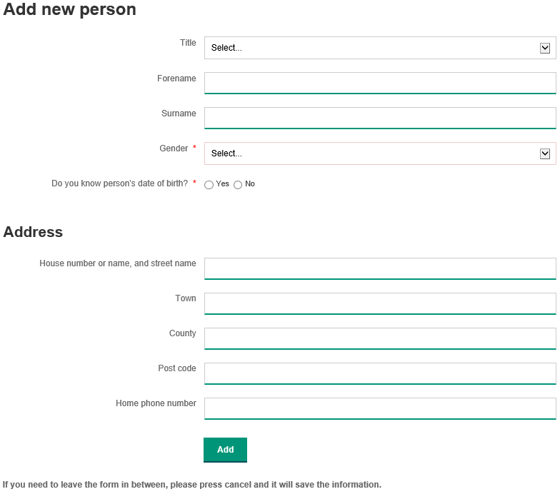
Adding a person to the database
Fill in the details of the person to the relevant fields, then press Add.
NOTE: It is not mandatory to add the person’s address at this stage; however, it will be required later in the form if the accident/incident is reportable under the Reporting of Injuries, Diseases and Dangerous Occurrences Regulations 2013 (RIDDOR).

Slide 14
Adding a person to the database
Once the person’s details have been added, the following question will appear (you may need to scroll to find it). Select Yes and then press Next to start the report.
1
2

Slide 15
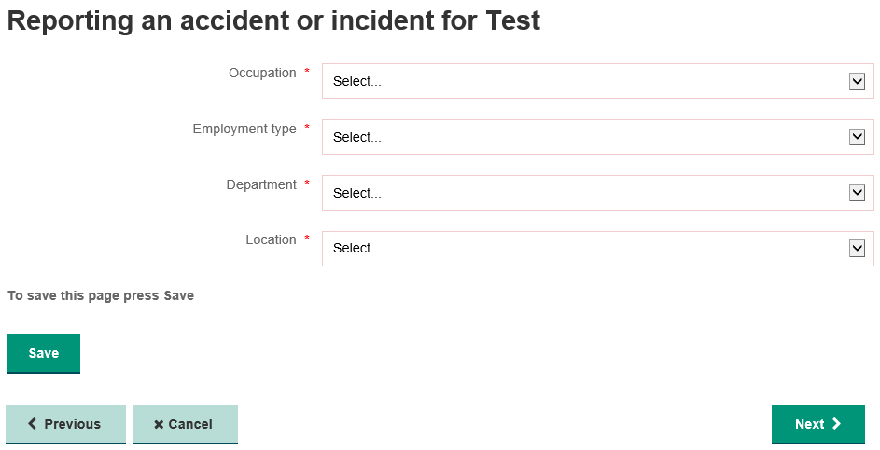
Layout – General Details
Fill in the fields with the details of the injured person, not yourself.
NOTE: Please ensure that you select the correct Department, otherwise the report will not be logged correctly.

Slide 16
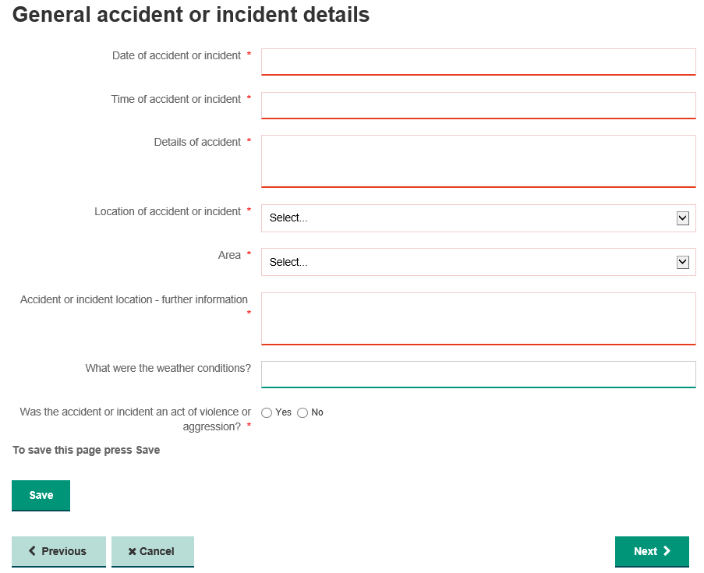
Layout – General Accident or Incident Details
NOTE: It is very important that you select Yes to this question if you believe the incident to be an act of violence or aggression (see the Corporate Policy on Violence at Work).
If not, press Next to continue.

Slide 17
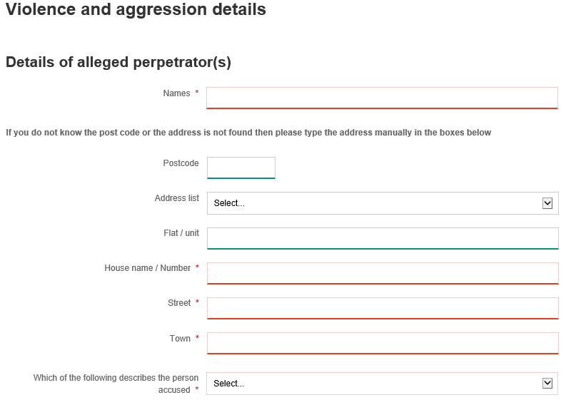
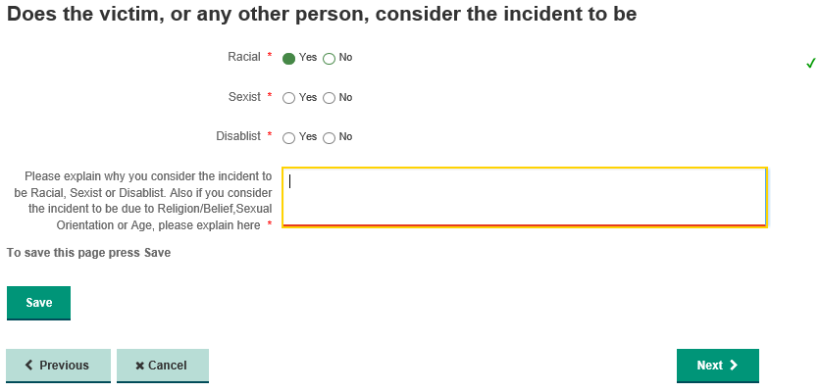
Layout – Potentially Violent Person Details
NOTE: If you did not mark the incident as violent or aggressive then move onto the next slide. Otherwise fill in the details and press ‘Next’.

Slide 18
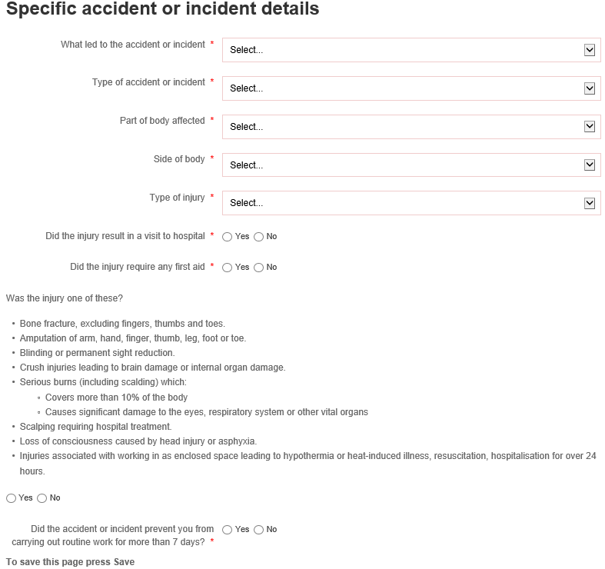
Layout - Specific Accident or Incident Details
NOTE: Please ensure these questions are answered correctly as they will determine whether this must also be reported to the Health and Safety Executive under the Reporting of Injuries and Diseases and Dangerous Occurrences Regulations (RIDDOR).

Slide 19
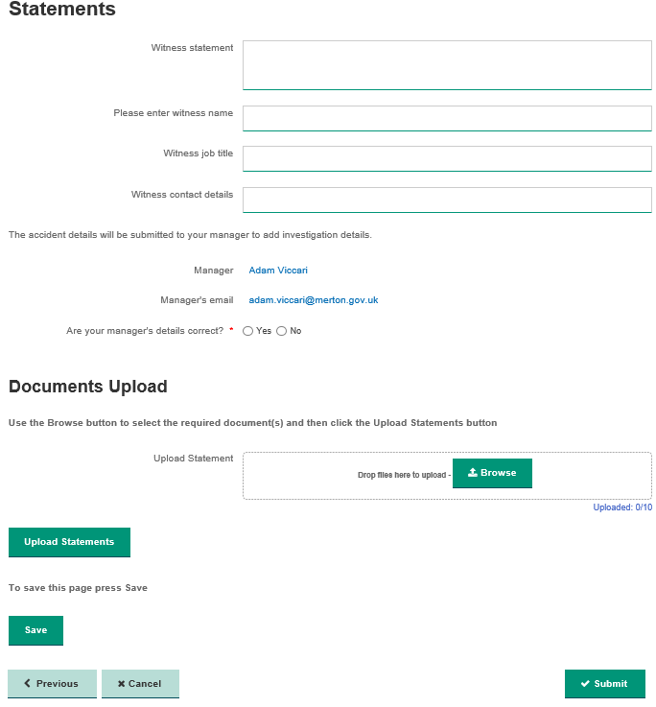
Layout - Statements
If your manager’s details are correct press Yes and on submission it will assigned to your manager
NOTE: If your manager’s details are not correct select No and type your manager’s full name and email address into the fields that appear.
You can now upload Witness Statements to the form. To do this, click Browse and find the document you wish to attach. Once it has appeared in the box, press the Upload Statements button and select the file you want to upload.
Once you are satisfied with the report, press Submit to send it to your line manager.

Slide 20
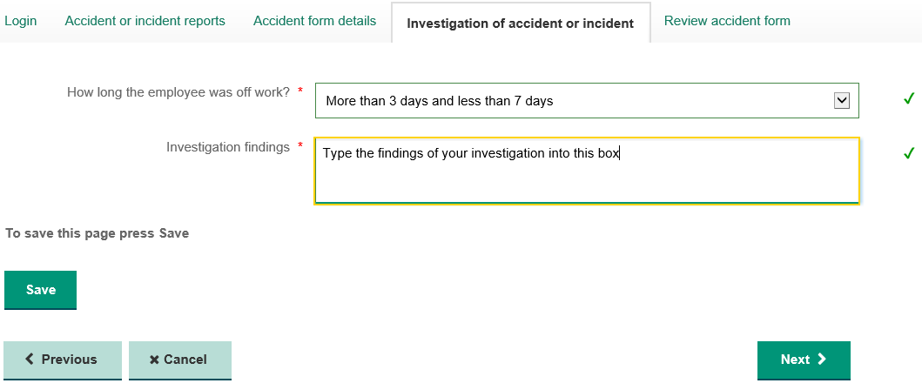
Layout - Investigation of Accident or Incident (Managers only)
NOTE: You will only see this page if your system permissions are set to ‘Manager’. If you are an Admin who only reports accidents/incidents for a manager or Head teacher to investigate, please jump straight to this slide.
Once you have confirmed how long the employee was off work and entered the details of your investigation, press Next to continue.
NOTE: This does not include non-employees!
This field only applies to the period of time that an employee was not able to perform their normal duties for, as this is a trigger for RIDDOR reporting.

Slide 21
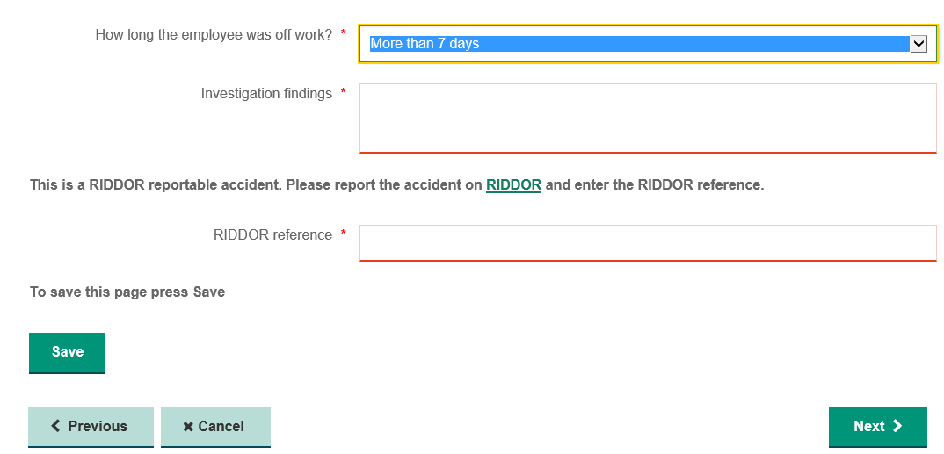
RIDDOR Reporting
For employees, the system will automatically remind you to report if an accident/incident is RIDDOR reportable. You can only complete this report on the HSE website and you will need the Injured Person’s date of birth and home address. Once you have reported it and received a reference from the HSE, please enter it in the RIDDOR Reference field and then press Next.
If the accident/incident is not reportable, please continue to the next slide
You can click this link to go directly to the RIDDOR site.
NOTE: If the incident involved a non-employee, such as a pupil, visitor or contractor, please refer to the Corporate Guidance on Accident Reporting for advice on whether it is RIDDOR Reportable.

Slide 22
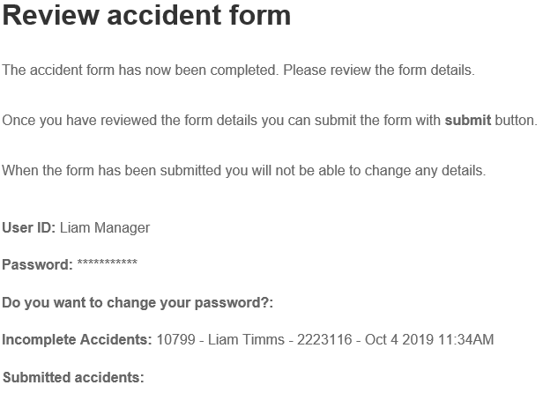
Reporting – Form submission (Admin only)
NOTE: This slide only applies to those with Admin permissions - if you report accidents/incidents and also complete investigations, please skip to the next slide.
Scroll down and review the report until you come to the Assign to Manager heading. Select the appropriate Investigating Manager from the dropdown and then click Submit to complete.
In schools, the Investigating Manager is usually the Head teacher or authorised Business Manager.
For Merton staff, the Investigating Manager is the Injured Person’s line manager.
NOTE: If you cannot find the correct person to submit the accident/incident for investigation, they will need to request access to the system.

Slide 23
Reporting – Form submission (Managers only)
NOTE: This slide only applies to those with Manager permissions, if you report accidents/incidents and submit them to another User to complete the investigation, please go back to the previous slide.
Scroll down and review
When you have reviewed the form, click Submit to finish.

Slide 24
Completing the Investigation Findings of a Pending Report (Managers only)
If you are a system user with Manager permissions, you are likely to be submitted accidents/incidents relating to your employees or that occur within your school or premises. You will receive an email when this happens that contains a link to the system. Click that link or go to https://www.merton.gov.uk/business-and-consumers/health-and-safety/health-and-safety-for-merton-staff-and-contractors/accident-and-incident-reporting and select the option highlighted below:

Slide 25
Completing the Investigation Findings of a Pending Report (Managers only)
Log in using the process shown on slides 4 – 6 and use the toggle next to the report you wish to complete under the Pending Forms heading and then scroll down and press Next, as shown below:
1
2
Scroll down to the bottom of the page
3

Slide 26
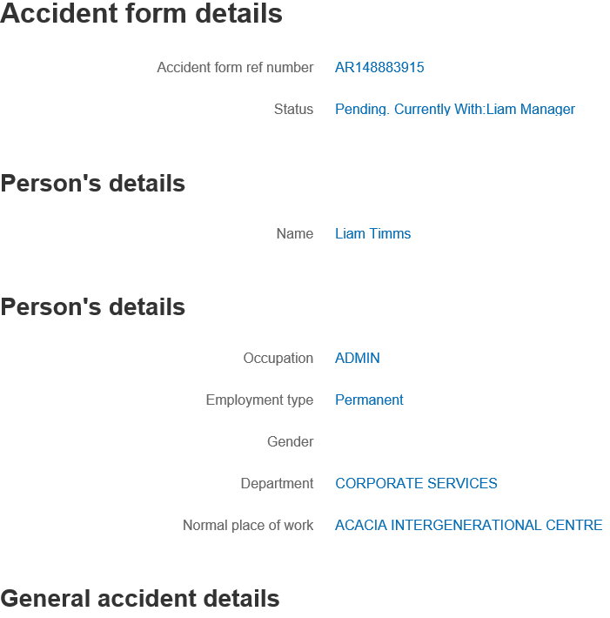
Investigation – Review Form
Scroll down and review the form and any attached Witness Statements that have been submitted to you to ensure that the information is correct before proceeding.
Once you have reviewed the form, press Next.

Slide 27
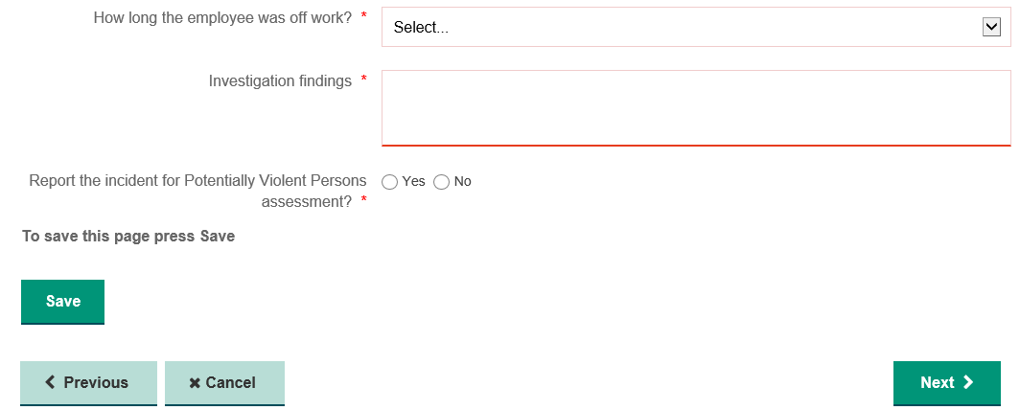
Investigation Findings
NOTE: It is vital that you select the period of time that an employee was not able to perform their normal duties, as this is a trigger for RIDDOR reporting. This does not include non-employees.
NOTE: If the incident was marked as violent or aggressive in nature, you will see this question. Refer to the Corporate Policy on Violence at Work for information on whether to forward this on for PVP Assessment. This is covered in the next slide.
Once you have confirmed if or how long the employee was off work and entered the details of your investigation, press Next to continue.

Slide 28
Investigation – Potentially Violent Persons (PVP)
The system also allows for the assessment and registration of Potentially Violent Persons in order to protect staff who may come into contact with violent or aggressive individuals through the course of their work. To start the process of referring an incident for assessment, select Yes to ‘Report the incident for Potentially Violent Persons assessment?’. If not,
You will be asked to select a Review Officer (RO) to complete the PVP assessment. The RO’s available for selection are based on your Department; you should choose your Head of Service or, in their absence, Assistant Director unless otherwise directed by the Corporate Safety Services Team.
In Schools, the RO will be the Head teacher.
Once you have selected the RO, press Next to continue.
If you have a query about this process, please contact the Safety Services Team at health.andsafety@merton.gov.uk or call 020 8545 3388.

Slide 29
Investigation - Final Review
Scroll down and review
Once you have reviewed the form, click Submit to finish.

